Slide 1

Selenium
Class 1

Slide 2
Agenda
What is Selenium? History of the Selenium Project
First Selenium Webdriver script
WebDriver Commands

Slide 3
Selenium
Selenium is a free (open source) automated testing suite for web applications across different browsers and platforms
Selenium is not just a single tool but a suite of software, each catering to different testing needs of an organization.
Selenium WebDriver tool is used to automate web applications and verify that it works as expected.
Selenium WebDriver supports many browsers such as Firefox, Chrome, IE, and Safari.
Using the Selenium WebDriver, we can automate testing for web applications only. It does not qualify for window-based applications.
Selenium WebDriver supports different programming languages such as C#, Java, JavaScript, Phyton, PHP and Ruby for writing test scripts.
Selenium Webdriver is platform-independent since the same code can be used on different Operating Systems like Microsoft Windows, Mac OS and Linux.

Slide 4
When to automate?
Frequent regression testing, whenever a new feature introduced to application we perform functional testing at the same time we also required to perform regression testing to ensure that new changes did not affect the existing functionality negatively.
Repeated test case execution is required, we may need to test few functionalities again and again for set of data like login details
Test same application on multiple environments.
Faster feedback to the developers, when developers deployed something tester must be able to give the details of the deployment effect on basic functionalities of the application.
Reduce the human effort, when we test a functionality manually it takes lot of time but automating reduces the effort

Slide 5
What type of tests we can automate with selenium
Selenium supports Functional Testing and Regression Testing of Web Applications
Functional Testing which includes Smoke Testing and Regression Testing.
Browser Compatibility Testing (Cross browser and Different versions of same browser)
UI Testing
Api Testing
Database Testing using drivers like JDBC can also be performed as it is a part of Functional Testing

Slide 6
Selenium WebDriver Pros
Selenium webdriver is pure open source, freeware and portable tool
Selenium webdriver supports many operating systems like Windows, Macintosh, Linux, Unix etc (platform independent)
It supports all popular web browsers
It supports parallel test execution
It can be utilized for regression, user interface, functional and UAT testing.
Supports to take screenshot of execution
Selenium can be integrated with continuous integration tools like Jenkins or Bamboo
Selenium Webdriver support third party tools like AutoIt, Sikuli, Apache POI, with help of the language

Slide 7
Selenium WebDriver Cons
Since it is open source tool, No reliable Technical support (Official Users Group, Chat room in seleniumhq.org)
It doesn't support Desktop Applications/Windows based applications
No Other tool integration for Test Management
Image verification is not possible
Additional Tools Required for Generating Reports.
New features may not work properly(with new browser driver executable like gecko, chrome functionalities like dragging mouse movement).
Good tests require good coders.

Slide 8
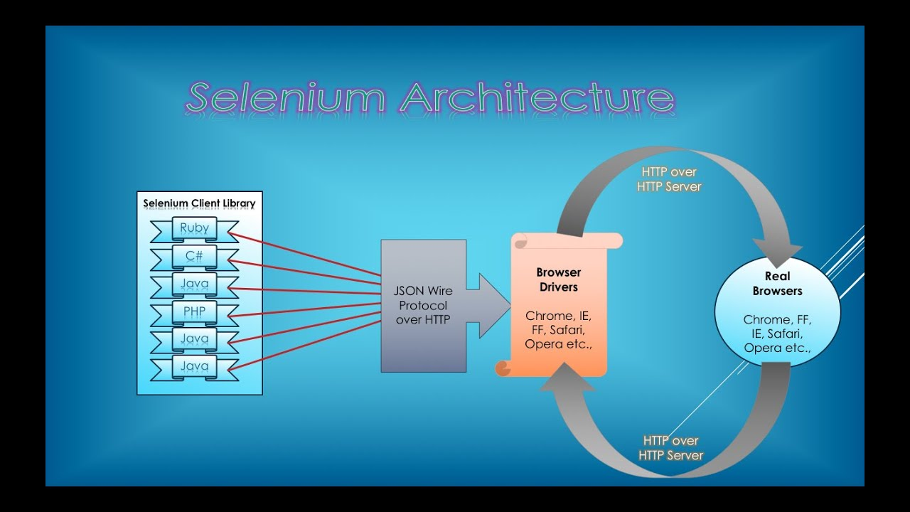
Selenium Webdriver Architecture
Before starting the automation using any automation tool, it is very important to know how that tool works and how it is architecture.

Slide 9
Selenium webdriver architecture divided into 3 parts
1) Language Level Bindings :
Bindings are language level bindings and with which we can implement the Selenium webdriver code. These the languages will interact with the Selenium Webdriver and work on various browsers and other devices. There’s Java, Java, Python, Ruby, there’s also some other bindings and new bindings can be added very easily.
2) Selenium Webdriver API: Now these bindings communicate with Selenium Webdriver API and this API send the commands taken from language level bindings interpret it and sent it to Respective driver. In basic term it contains set of common library which allow to send command to respective drivers.
3) Drivers:
We have various internet browser specific drivers such as IE driver, a Firefox, Chrome, and other Drivers such as HTML.

Slide 10
How all blocks work together?
So what’s happening here we are going to write test in Java and we are going to be using common Selenium API and that Java binding is going to be sending command across this common WebDriver API.
Now on the other end is going to be listening a driver, It’s going to interpret those commands and it’s going to execute them on the actual browser and then it’s going to return the result backup using the WebDriver API to our code where we can look at that result.

Slide 11
WebDriver Cannot Readily Support New Browsers
Remember that WebDriver operates on the OS level. Also, remember that different browsers communicate with the OS in different ways.
If a new browser comes out, it may have a different process of communicating with the OS as compared to other browsers. So, we have to give the WebDriver team quite some time to figure that new process out before they can implement it on the next WebDriver release.
However, it is up to the WebDriver's team of developers to decide if they should support the new browser or not.

Slide 12
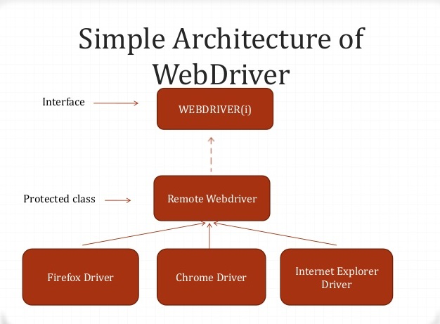
Selenium Webdriver Architecture

Slide 13
First Selenium WebDriver Script
As selenium webdriver supports only web based application, opening a browser for operation is must.
We cannot access already opened browser in selenium
To open Chrome Browser
WebDriver driver=new ChromeDriver();
To open Firefox Browser
WebDriver driver=new FirefoxDriver();
To open IE Browser
WebDriver driver=new InternetExplorerDriver();

Slide 14
First Selenium WebDriver Script
WebDriver - webdriver is the interface which is inherited from SearchContext
new - new is the keyword in java which creates an object (address space)in the heap area of CPU
FirefoxDriver() - FirefoxDriver() is a constructor of FirefoxDriver class which implements all the methods in the present in the webdriver interface and this opens the firefox Browser .
driver - driver is reference variable ,which refers the address space created on heap.

Slide 15
Steps
Set System Property
System.setProperty(key, value)
Instantiate objects and variables
WebDriver driver=new ChromeDriver();
Launch a Browser Session
WebDriver's get() method is used to launch a new browser session and directs it to the URL that you specify as its parameter.
Get the Actual Page Title
The WebDriver class has the getTitle() method that is always used to obtain the page title of the currently loaded page.
Terminate a Browser Session
The "close()" method is used to close the browser window.

Slide 16
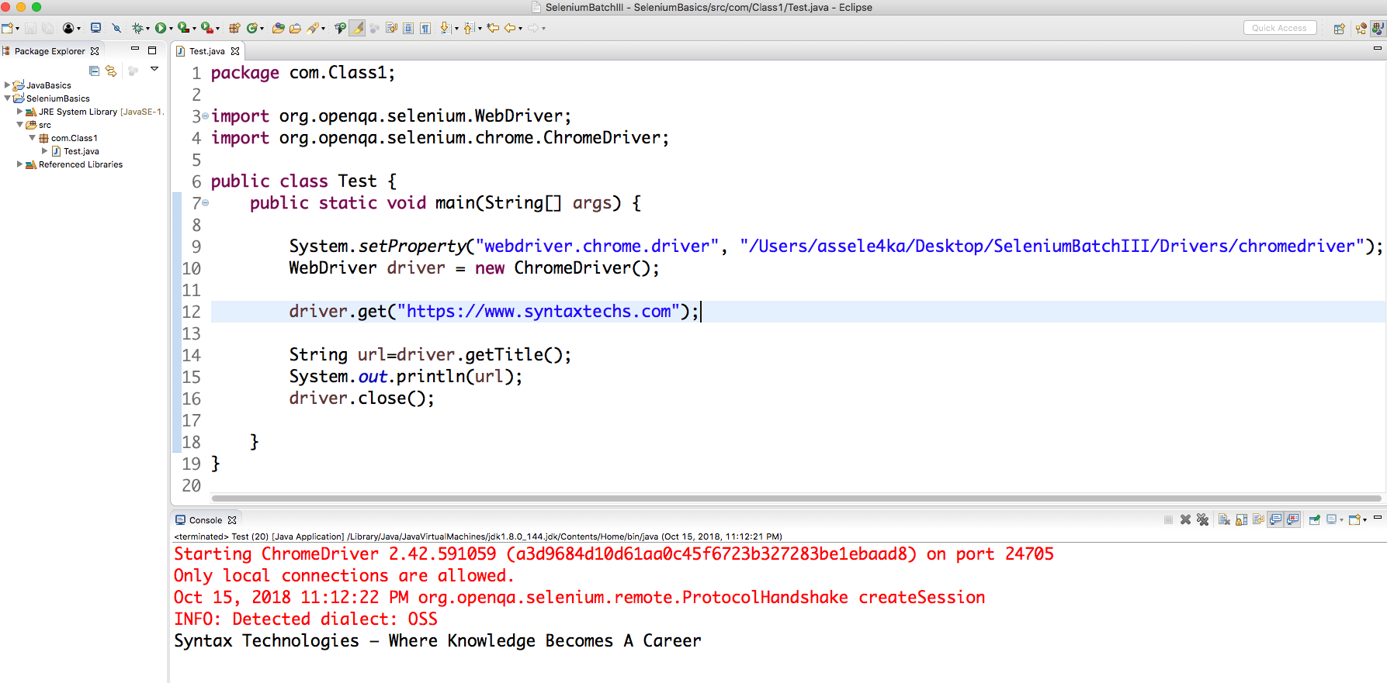
Chrome Demo

Slide 17
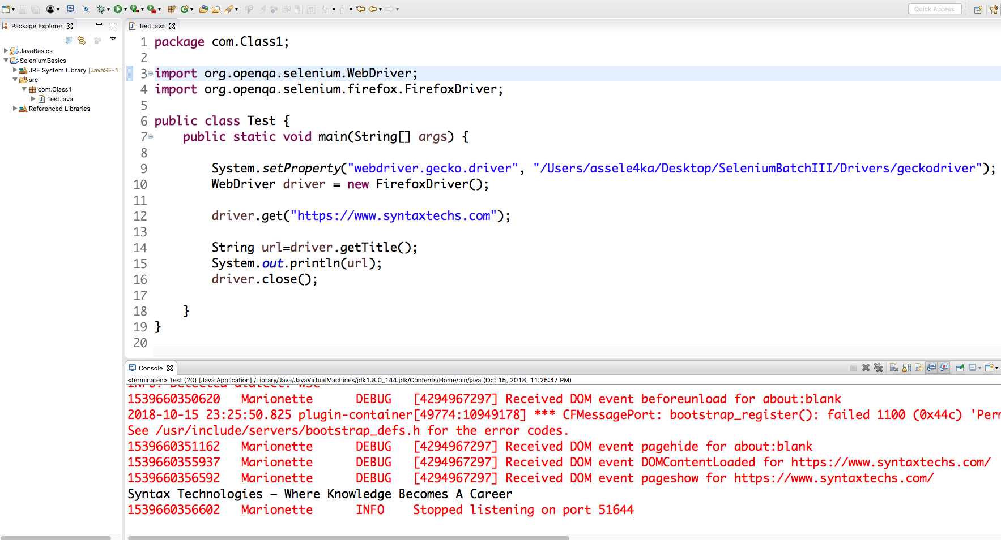
Firefox Demo

Slide 18
Test Case
TC 1: Opening Page on Chrome Browser
Open Chrome Browser
Navigate to “https://github.com/”
TC 2: Opening Page on Firefox Browser
Open Firefox browser
Navigate to “https://www.redfin.com/”

Slide 19
WebDriver Browser Commands
get(String url);
Command launches a new browser and opens the specified URL in the browser instance
The command takes a single string type parameter that is usually a URL of application under test
driver.get("https://google.com");
//Or can be written as
String URL = "https://google.com";
driver.get(URL);
getTitle();
Command is used to retrieve the title of the webpage the user is currently working on.
A null string is returned if the webpage has no title
Command doesn’t require any parameter and returns a trimmed string value
String title = driver.getTitle();

Slide 20
WebDriver Browser Commands
close(); This method Close only the current window the WebDriver is currently controlling. Accepts nothing as a parameter and returns nothing. Quit the browser if it’s the last window currently open. driver.close(); | quit(); This method Closes all windows opened by the WebDriver. Accepts nothing as a parameter and returns nothing. Close every associated window. driver.quit();

Slide 21
WebDriver Navigation Commands
navigate().to(String url);
This method Loads a new web page in the current browser window. It accepts a String parameter and returns nothing.
It does exactly the same thing as the driver.get(String url) method.
Able to redirect from the current web page to the expected web page.
driver.navigate().to("https://www.google.com");
navigate().refresh();
This method Refresh the current page. It neither accepted nor returns anything.
Perform the same function as pressing F5 in the browser.
driver.navigate().refresh();

Slide 22
WebDriver Navigation Commands
navigate().forward(); This method does the same operation as clicking on the Forward Button of any browser. It neither accept nor returns anything. Takes you forward by one page on the browser’s history. driver.navigate().forward(); | driver.navigate().back(); This method does the same operation as clicking on the Back Button of any browser. It neither accepted nor returns anything. Takes you back by one page on the browser’s history. driver.navigate().back();

Slide 23
Difference Between get() and navigate()
driver.get("URL") | driver.navigate().to("URL")
driver.get("http://www.google.com"); | driver.navigate().to("http://www.google.com");
It's used to go to the particular website , But it doesn't maintain the browser History and cookies, we can't use forward and backward button , if we click on that , page will not get schedule | It's used to go to the particular website , but it maintains the browser history and cookies, we can use forward and backward button to navigate between the pages during the coding of Testcase
is used to navigate particular URL(website) and wait till page load. | is used to navigate to particular URL and does not wait to page load

Slide 24
Test Case
TC 1: Amazon Page Title Verification:
Open chrome browser
Go to “https://www.amazon.com/”
Verify Title “Amazon.com: Online Shopping for Electronics, Apparel, Computers, Books, DVDs & more” is displayed
TC 2: Syntax Page URL Verification:
Open chrome browser
Navigate to “https://www.zillow.com/”
Navigate to “https://www.google.com/”
Navigate back to Zillow Page
Refresh current page
Verify url contains “Zillow”

Slide 25
Selenium
Class 2

Slide 26
Agenda
What is an element?
Locators in Selenium

Slide 27
What are objects or webelements in a webpage?
A Web Page consists of buttons, links, inputs boxes, drop-down lists, check-boxes, radio buttons, plain texts and other items. These are called Web Elements or Objects in Test Automation.
In order to perform actions (like click, type, select etc) on these elements, Selenium needs to locate them uniquely in page. And to help Selenium locate them we need to identify their properties in page to pass them to Selenium.

Slide 28
What are Locators ?
In Selenium Automation, Locators are used to locate the UI (User Interface) elements of a page like Text Box field, Button etc
Locator can be termed as an address that identifies a web element uniquely within the webpage
Locators are the HTML properties of a web element which tells the Selenium about the web element it need to perform action on.
Locators are: Identifying an UI element on the application screen as an important feature for any automation tool. Locators allows the Selenium Automation tool to find UI elements on a page that can be used in our automation tests.

Slide 29
What are Locators ?
The Selenium Tool uses Locators to find and match the elements on your page that it needs to interact with while running the automation scripts.
Locators are the lifeblood of the tests. Using the right locator ensures the tests are faster, more reliable or has lower maintenance over releases.
If you’re fortunate enough to be working with unique IDs and Classes, then you’re usually all set. But there will be times when choosing a right locator will become a nightmare.
It can be a real challenge to verify that you have the right locators to accomplish what you want.

Slide 30
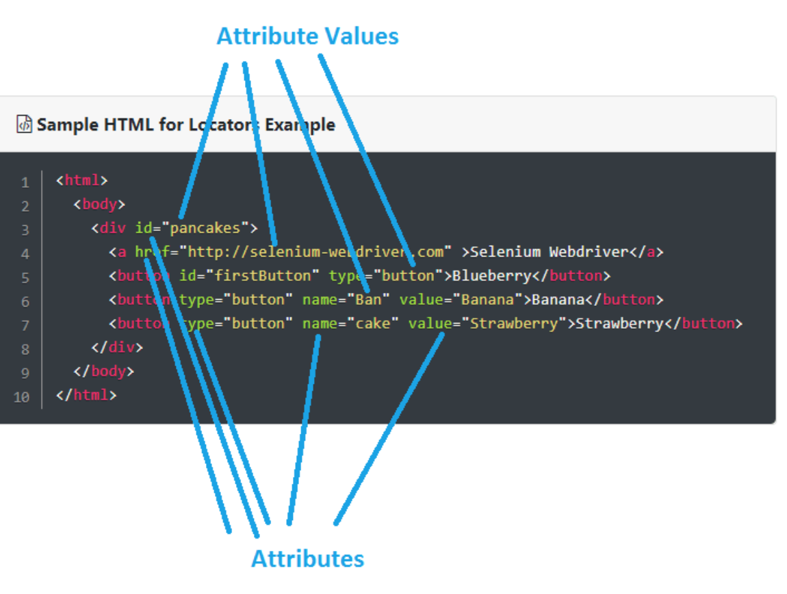
Sample of HTML Locators

Slide 31
Locating Web Elements in Browser
Now days, it is very easy to find elements on the page. All the modern browsers have the web inspector, the built-in tool for to easily examine the structure of web pages.
To identify to which element this refers to just do the following:
Open the URL / web page in the Chrome browser
Open the Web developer tools by pressing:
Cmd + Alt + I (on Mac)
or by clicking View -> Developer -> Developer tool
or by Right-Click and Inspect Element

Slide 32
Locating Web Elements in Google Chrome
Google Chrome has its own developer tool that can be used to identify and locate web elements on the web page.
Follow the below steps to locate web elements using Chrome’s Developer tool:
Step #1: The primary step is to launch the Google Chrome’s Developer tool. Press F12 to launch the tool.
You can also launch developer tool by right-clicking anywhere within the web page and by selecting “Inspect element”
Step #2: The next step is to locate the desired object within the web page. One way to do the same is to right click on the desired web element and inspect. The HTML property belonging to that web element would be highlighted in the developer tool.
Another way is to hover through the HTML properties and the matching web element would be highlighted. Thus, in this way user can locate ids, class, links etc.

Slide 33
Locating Web Elements in Internet Explorer
Internet Explorer also has its own Developer Tool that can be used to identify web elements based on their properties within the web page.
Follow the below steps to locate web elements using IE Developer tool:
Step #1: The primary step is to launch the IE Developer tool.
Press F12 to launch the tool. The user would be able to see something like the below screen.
Step #2: The next step is to locate the desired object within the web page. One way to this is to select the HTML element and the matching web element would be highlighted.
Thus, in this way user can locate ids, class, links etc. Check out in the below screenshot in which Email Textbox would be highlighted as soon as we select the corresponding HTML property.

Slide 34
Locating GUI Elements
Locating elements in WebDriver is done by using the "findElement(By.locator())" method.
Selenium webdriver uses 8 locators to find the elements on web page:
ID
Name
LinkText
partialLinkText
className
tagName
XPath
CSS Selector

Slide 35
Locators
Id - Select element with the specified @id attribute.
Name - Select first element with the specified @name attribute.
Linktext - Select link (anchor tag) element which contains text matching the specified link text
Partial Linktext - Select link (anchor tag) element which contains text matching the specified partial link text
Tag Name - Locate Element using a Tag Name
Class name - Locate Element using a Class Name
Css - Select the element using css selectors
Xpath - Locate an element using an XPath expression.

Slide 36
UI elements using the following example:
Example#1
Suppose we've to automate a test, where the User have to log in to Facebook Steps to Log In to Facebook application:
Browse www.facebook.com in any browser
On 'Facebook' login page, enter your email id into the Username text box.
Enter your Facebook password into the Password text box.
Click on 'Log In' button.
In the above example, Username text box, Password text box and Log In text box are the UI elements to be identified by the automation tool.

Slide 37
Locating an Element By ID
Ids are the most preferred way to locate elements on a page, as each id is supposed to be unique which makes ids a very faster and reliable way to locate elements.
IDs are the safest and fastest locator option and should always be the first choice even when there are multiple choices, It is like an Employee Number or Account which will be unique.
With this strategy, the first element with the id attribute value matching the location will be returned. If no element has a matching id attribute, a NoSuchElementException will be raised.

Slide 38
Locating an Element By ID
<div id="toolbar">....</div>
<input id="email" class="required" type="text"/>
We can write the scripts as
WebElement Ele = driver.findElement(By.id("toolbar"));
or
WebElement emailEle = driver.findElement(By.id("email"));
Even though this is a great locator, obviously it is not realistic for all objects on a page to have ids. In some cases developers make it having non-unique ids on a page or auto-generate the ids, in both cases it should be avoided.

Slide 39
Locating an Element By Name
When there is no ID to use, the next worth seeing if the desired element has a name attribute. But make sure there the name cannot be unique all the times. If there are multiple names, Selenium will always perform action on the first matching element
If no element has a matching name attribute, a NoSuchElementException will be raised.
Example:
<input name="register" class="required" type="text"/>
WebElement register= driver.findElement(By.name("register"));

Slide 40
Locating an Element By LinkText
Finding an element with link text is very simple. But make sure, there is only one unique link on the web page.
If there are multiple links with the same link text (such as repeated header and footer menu links), in such cases Selenium will perform action on the first matching element with link
With this you can find elements of “a” tags(Link) with the link names. Use this when you know link text used within an anchor tag.
<a href="http://www.seleniumhq.org">Downloads</a>
WebElement download = driver.findElement(By.linkText("Downloads"));

Slide 41
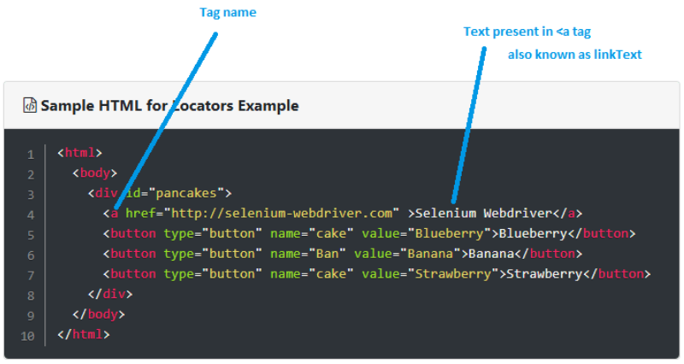
Locating an Element By LinkText

Slide 42
Locating an Element By Partial LinkText
In the same way as LinkText, PartialLinkText also works in the same pattern.
User can provide partial link text to locate the element.
<a href="seleniumhq.org">Download selenium server</a>
WebElement download = driver.findElement(By.PartialLinkText("Download"));

Slide 43
Locating an Element By TagName
TagName can be used with Group elements like , Select and checkboxes / dropdowns.
<h1>Welcome</h1>
driver.findElement(By. tagName (“h1"));
<select> <option value="volvo">Volvo</option> <option value="saab">Saab</option> <option value="mercedes">Mercedes</option> <option value="audi">Audi</option> </select>
Select select = new Select(driver.findElement(By.tagName("select"))); select.selectByVisibleText(“Audi");

Slide 44
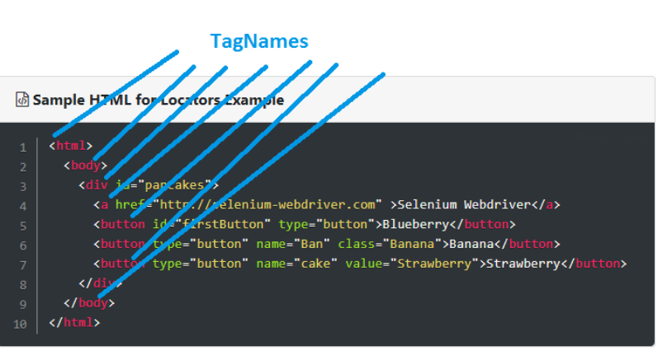
Locating an Element By TagName
The tagname locator looks for an element in the page having an tagname, like <a>, <button>, <p>, <label>, <div> etc

Slide 45
Locating an Element By Class Name
There may be multiple elements with the same name, if we just use findElementByClassName , make sure it is only one.
If not then you need to extend using the className and its sub elements.
<input id="gbqfq" class=“Password" type="text" value="" autocomplete="off" name="q" style="border: medium none; padding: 0px; margin: 0px; height: auto…; width: 100%; background: url('" dir="ltr" spellcheck="false"></input>
WebElement login= driver.findElement(By.className(“Password"));

Slide 46
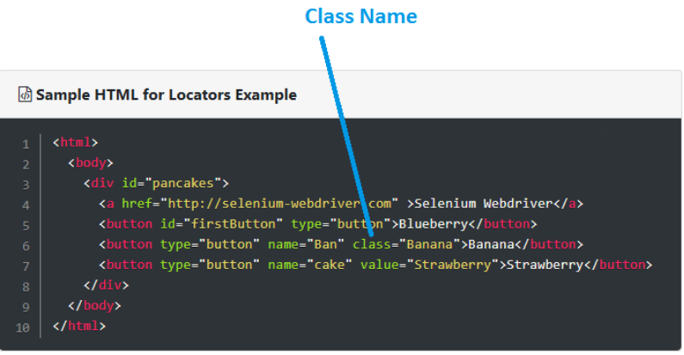
Locating an Element By Class Name
The Class name locator looks for an element in the page having an class attribute

Slide 47
Test Case
TC 1: Facebook login:
Open chrome browser
Go to “https://www.facebook.com/”
Enter valid username and valid password and click login
User should see invalid user name Page.
Close the browser
TC 2: Mercury Tours Registration:
Open chrome browser
Go to “http://newtours.demoaut.com/”
Click on Register Link
Fill out all required info
Click Submit
User successfully registered
(Create 2 scripts using different locators)

Slide 48
HomeWork
TC 1: Facebook sign up:
Open chrome browser
Go to “https://www.facebook.com/”
Enter first name
Enter last name
Enter mobile number
Click on sign up button

Slide 49
Selenium
Class 3

Slide 50
Agenda
Xpath and CSS Locators

Slide 51
Xpath
XPath is the language used when locating XML (Extensible Markup Language) nodes. Since HTML can be thought of as an implementation of XML, we can also use XPath in locating HTML elements.
Advantage: It can access almost any element, even those without class, name, or id attributes.
Disadvantage: It is the most complicated method of identifying elements because of too many different rules and considerations.
Types of Xpath:
1. Native Xpath(Absolute )
2. Relative Xpath

Slide 52
Native Xpath(Absolute )
Also called complete or full xpath. Absolute xpath starts from <html> tag or it starts from single slash (/).
it is like directing the xpath to go in direct way. like
html/body/div/div[5]/div/div/div/div/div/div/div/div[2]/div/form/fieldset/div[8]/input[@name='firstname']
Example: firstname field
toolsqa
Here the advantage of specifying native path is, finding an element is very easy as we are mention the direct path.
But if there is any change in the path (if something has been added/removed) then that xpath will break.

Slide 53
Relative Xpath
In relative xpath we will provide the relative path, it is like we will tell the xpath to find an element by telling the path in between.
A relative xpath is one where the path starts from the node of your choice - it doesn't need to start from the root node. It starts with Double forward slash (//).
Advantage here is, if at all there is any change in the html that works fine, until unless that particular path has changed. Finding address will be quite difficult as it need to check each and every node to find that path.
//table/tr/td

Slide 54
Create Customized xpaths
To customize the xpath. It's very easy to create the customized xpath. Xpath has an fix structure like
Tag is our HTML tag(like - div, input, name etc), attribute is our HTML attribute (like - Id, class etc), and Value is the value of that HTML attribute.
XPath locators are very powerful and flexible. Any element on the page can be located via one or more XPaths and most other locators can be expressed as an XPath.
Except CSS Selectors, no other locators share this feature. A well-written XPath can be very robust, but a poor XPath can be fragile, and may break when the application changes.
//tag[@attribute=’value’]

Slide 55
Construct partial Xpath by using XPath functions
contains() : It is used when the value of any attribute changes dynamically,The contain feature has an ability to find the element with partial text
to use it with a text:
‘starts-with() : Start-with function finds the element whose attribute value changes on refresh or any operation on the webpage. In this expression, match the starting text of the attribute is used to find the element whose attribute changes dynamically.
to use it with a text:
//img[contains(@src,' imdbpro')]
//img[contains( text(),' imdbpro')]
//img[starts-with(@alt,’ IMDbPro’)]
//img[starts-with(text(), ’IMDbPro’)]

Slide 56
Test Case
Using Xpath ONLY
TC 1: Facebook login:
Open chrome browser
Go to “https://www.facebook.com/”
Enter valid username and valid password and click login
User successfully logged in

Slide 57
CSS Selector
When we don't have an option to choose Id or Name, we should prefer using CSS selector as the best alternative.
CSS is "Cascading Style Sheets" and it is defined to display HTML in structured and colorful styles are applied to webpage.
CSS has more Advantage than Xpath
CSS is much more faster and simpler than the Xpath.
In IE Xpath works very slow, whereas Css works faster when compared to Xpath.

Slide 58
CSS Selector
CSS Selectors have many formats, but we will only focus on the most common ones.
Tag and ID Tag and class Tag and attribute

Slide 59
Locating by CSS Selector - Tag and ID
Syntax | Description
css=tag#id | tag = the HTML tag of the element being accessed # = the hash sign. This should always be present when using a CSS Selector with ID id = the ID of the element being accessed
<a id="current time" href="http://someurl/" onclick="s_objectID="http://someur/">url</a>
WebElement element = driver.findElement(By.cssSelector("a[id='current time']"));
Or
WebElement element = driver.findElement(By.cssSelector("a#current time"));

Slide 60
Locating by CSS Selector - Tag and Class
Syntax | Description
css=tag.class | tag = the HTML tag of the element being accessed . = the dot sign. This should always be present when using a CSS Selector with class class = the class of the element being accessed
<a class="current time" href="http://someurl/" onclick="s_objectID="http://someur/">url</a>
WebElement element = driver.findElement(By.cssSelector("a[class='current time']"));
Or
WebElement element = driver.findElement(By.cssSelector("a.current time"));

Slide 61
Locating by CSS Selector - Tag and Attribute
Syntax | Description
css= tag[attribute=’value’] | tag = the HTML tag of the element being accessed [ and ] = square brackets within which a specific attribute and its corresponding value will be placed attribute = the attribute to be used. It is advisable to use an attribute that is unique to the element such as a name or ID. value = the corresponding value of the chosen attribute.
<input class="name" id="name" type="text" placeholder="Enter name..." />
WebElement element = driver.findElement(By.cssSelector(“input[placeholder=‘Enter name...’]"));

Slide 62
There are there important special characters:
1. '^' symbol, represents the starting text in a string. 2. '$' symbol represents the ending text in a string. 3. '*' symbol represents contains text in a string.
CSS Locators for substring matches(Start, end and containing text) in selenium

Slide 63
It will find input tag which contains 'id' attribute starting with 'ema' text. Email starts with 'ema'
It will find input tag which contains 'id' attribute ending with 'ail' text. Email ends with 'mail‘
It will find input tag which contains 'id' attribute containing 'mai' text. Email contains 'mai‘
css=input[id^='ema']
css=input[id$='mail']
css=input[id*='mai']

Slide 64
Test Case
Using Css ONLY
TC 1: Facebook login:
Open chrome browser
Go to “https://www.facebook.com/”
Enter valid username and valid password and click login
User successfully logged in

Slide 65
HomeWork
Using xPath ONLY
TC 2: Mercury Tours Registration:
Open chrome browser
Go to “http://newtours.demoaut.com/”
Click on Register Link
Fill out all required info
Click Submit
User successfully registered
Using Css ONLY
TC 2: Mercury Tours Registration:
Open chrome browser
Go to “http://newtours.demoaut.com/”
Click on Register Link
Fill out all required info
Click Submit
User successfully registered

Slide 66
Selenium
Class 4

Slide 67
Agenda
WebElement Commands
Radio Buttons and CheckBoxes

Slide 68
WebElement Commands
WebDriver either returns something or return void(means return nothing). The same way findElement command of WebDriver returns WebElement. So, to get the WebElement object write the below statement:
WebElement element = driver.findElement(By.id(“UserName“));
And now if you type element dot, Eclipse will populate the complete list of actions
One more thing to notice that WebElement can be of any type, like it can be a Link, Radio Button, Drop Down, Web Table or any HTML element.

Slide 69
WebElement Commands
sendKeys(CharSequence… keysToSend ) : void - This simulate typing into an element, which may set its value. This method accepts CharSequence as a parameter and returns nothing.
Command - element.sendKeys(“text”);
This method works fine with text entry elements like INPUT and TEXTAREA elements.
WebElement element = driver.findElement(By.id("UserName"));
element.sendKeys("SyntaxTech");
//Or can be written as
driver.findElement(By.id("UserName")).sendKeys("SyntaxTech");

Slide 70
WebElement Commands
clear( ) : void - If this element is a text entry element, this will clear the value. This method accepts nothing as a parameter and returns nothing.
Command - element.clear();
This method has no effect on other elements. Text entry elements are INPUT and TEXTAREA elements.
WebElement element = driver.findElement(By.name("UserName"));
element.clear();
//Or can be written as
driver.findElement(By.name("UserName")).clear();

Slide 71
WebElement Commands
click( ) : void - This simulates the clicking of any element. Accepts nothing as a parameter and returns nothing.
Command - element.click();
Clicking is perhaps the most common way of interacting with web elements like text elements, links, radio boxes and many more.
WebElement element = driver.findElement(By.linkText("Pricing"));
element.click();
//Or can be written as
driver.findElement(By.linkText("Pricing")).click();

Slide 72
WebElement Commands
submit( ) : void- This method works well/better than the click() if the current element is a form, or an element within a form. This accepts nothing as a parameter and returns nothing.
Command - element.submit();
If this causes the current page to change, then this method will wait until the new page is loaded.
WebElement element = driver.findElement(By.xpath("//*[@value=”Login”]"));
element.submit();
//Or can be written as
driver.findElement(By.xpath("//*[@value=”Login”]")).submit();

Slide 73
WebElement Commands
isDisplayed( ) : boolean - This method determines if an element is currently being displayed or not. This accepts nothing as a parameter but returns boolean value(true/false). Command - element.isDisplayed(); | isEnabled( ) : boolean - This determines if the element currently is Enabled or not? This accepts nothing as a parameter but returns boolean value(true/false). Command - element.isEnabled();
isSelected( ) : boolean - Determine whether or not this element is selected or not. This accepts nothing as a parameter but returns boolean value(true/false). Command - element.isSelected(); This operation only applies to input elements such as Checkboxes, Select Options and Radio Buttons. Th

Slide 74
WebElement Commands
getText( ) : String- This method will fetch the visible (i.e. not hidden by CSS) innerText of the element. This accepts nothing as a parameter but returns a String value.
Command - element.getText();
This returns an innerText of the element, including sub-elements, without any leading or trailing whitespace.
WebElement element = driver.findElement(By.xpath("//*[@value=”Login”]"));
String elementString = element.getText();
//Or can be written as
String elementString = driver.findElement(By.xpath("//*[@value=”Login”]")).getText();

Slide 75
WebElement Commands
getAttribute(String Name) : String- This method gets the value of the given attribute of the element. This accepts the String as a parameter and returns a String value.
Command - element.getAttribute();
Attributes are Ids, Name, Class extra and using this method you can get the value of the attributes of any given element.
WebElement element = driver.findElement(By.id("SubmitButton"));
String attValue = element.getAttribute("id");
//This will return "SubmitButton"

Slide 76
Test Case
TC 1: HRMS Application Login:
Open chrome browser
Go to “http://166.62.36.207/humanresources/symfony/web/index.php/auth/login”
Enter valid username and password
Click on login button
Then verify Syntax Logo is displayed.
TC 2: HRMS Application Negative Login:
Open chrome browser
Go to “http://166.62.36.207/humanresources/symfony/web/index.php/auth/login”
Enter valid username
Leave password field empty
Verify error message with text “Password cannot be empty” is displayed.

Slide 77
Difference between FindElement & FindElements Commands
The difference between findElement() and findElements() method is the first returns a WebElement object otherwise it throws an exception and the findElements() returns a List of WebElements, it can return an empty list if no DOM elements match the query.
findElement() | findElements()
On Zero Match : throws NoSuchElementException On One Match : returns WebElement On One+ Match : returns the first appearance in DOM | On Zero Match : return an empty list On One Match : returns list of one WebElement only On One+ Match : returns list with all matching instance

Slide 78
Test Case
TC 1: Amazon link count:
Open chrome browser
Go to “https://www.amazon.com/”
Get all links
Get number of links that has text
Print to console only the links that has text

Slide 79
CheckBox & Radio Button Operations
CheckBox & Radio Button Operations are easy to perform and most of the times the simple ID attributes work fine for both of these.
But selection and d-selection is not the only thing we want with Checkboxes and Radio Buttons. We might like to check that if the Checkbox is already checked or if the Radio Button is selected by default or anything.
Checkboxes and Radio Button deals exactly the same way and you can perform below mentioned operations on either of them.

Slide 80
CheckBox & Radio Button Operations
Various methods to select checkbox and radio button.
1.1- Use ID for Selecting Checkbox/Radio button.
You can use the ID attribute to select a Radio Button or a CheckBox. We’ve provided the Webdriver command to click which you can apply to both types of elements.
1.2- Use IsSelected Method to Check the State of Checkbox/Radio button.
If you’ve selected/deselected a Checkbox/Radio Button and you just want to check its final state.
Then, you can use the <IsSelected> command to know that the correct status of the element.

Slide 81
Working with Radio Button/CheckBoxes
// Store all the elements of the same category in the list of WebElements.
List<WebElement> list = driver.findElements(By.name("radioButton"));
// Create a boolean variable to store true/false.
Boolean is_selected = list.get(0).isSelected();
// If 'is_selected' is true that means the first radio button is selected.
if (is_selected == true) {
// If the first radio button is selected by default then, select the second radio button.
list.get(1).click();
} else {
// If the first radio button is not selected then, click the first radio button.
list.get(0).click();
}

Slide 82
CheckBox & Radio Button Operations
Note: When there is a group of Radio Buttons/Check Boxes on the page then, it is possible that their names are same, but values are different. That’s why we’ve used the Webdriver findElements command to get the list of web elements.
1.3- Use Element Value for Selecting Checkbox/Radio button.
One of the intuitive ways to select the Radio Buttons/Check Boxes is by toggling their Values. Please follow the below code example for more clarity.

Slide 83
Working with Radio Button/ Checkboxes
// Get radio group
List<WebElement> radioBtn=driver.findElements(By.name("sex"));
// Now loop from first checkbox to last checkbox.
for(WebElement radio: radioBtn) {
//Store the checkbox name to the string variable, using 'Value' attribute
String value=radio.getAttribute("value");
//check if values is same as you want and element is enabled
if(radio.isEnabled() && value.equals("Female")) {
// click on that element
radio.click();
// This statement will get you out of the for loop.
break;
}

Slide 84
Test Case
TC 1: Checkbox Practice
Open chrome browser
Go to “http://jiravm.centralus.cloudapp.azure.com:8081/index.html”
Click on “Input Forms” links
Click on “Checkbox Demo” links
Click on checkbox inside a single demo section
Verify checkbox has been clicked successfully
Click on all checkboxes 1 by 1 in Multiple Checkbox Demo section.
Quit browser

Slide 85
HomeWork
TC 1: Syntax Demo input boxes count:
Open chrome browser
Go to “http://jiravm.centralus.cloudapp.azure.com:8081/index.html”
Click on “Input Forms” links
Click on “Simple Form Demo” links
Get all input boxes from the page
Enter “Hello” to each text box
Close browser
TC 2: Radio Buttons Practice
Open chrome browser
Go to “http://jiravm.centralus.cloudapp.azure.com:8081/index.html”
Click on “Input Forms” links
Click on “Radio Buttons Demo” links
Click on any radio button in “Radio Button Demo” section.
Verify correct radio is clicked
Click on any radio button in “Group Radio Buttons Demo” section.
Verify correct checkbox is clicked
Quit browser

Slide 86
Selenium
Class 5

Slide 87
Agenda
Working with DropDowns

Slide 88
DropDown & Multiple Select Operation
DropDown & Multiple Select Operations also works together and almost the same way.
To perform any action, the first task is to identify the element group. It is a group, as DropDown /Multiple Select is not a single element.
They always have a single name but they contains one or more than one elements in them/more than one option in DropDown and Multiple Select.
The only difference between these two is deselecting statement & multiple selections are not allowed on DropDown

Slide 89
DropDown & Multiple Select Operation
To work with drop down we can choose it by ID, Name, Css & Xpath etc.
To perform any action on drop down element it is required to import ‘import org.openqa.selenium.support.ui.Select' package and to use it we need to create a new Select Object of class Select.
Selenium webdriver provides Select class, with help of select class we can handle dropdowns on the webpage
Select s = new Select()

Slide 90
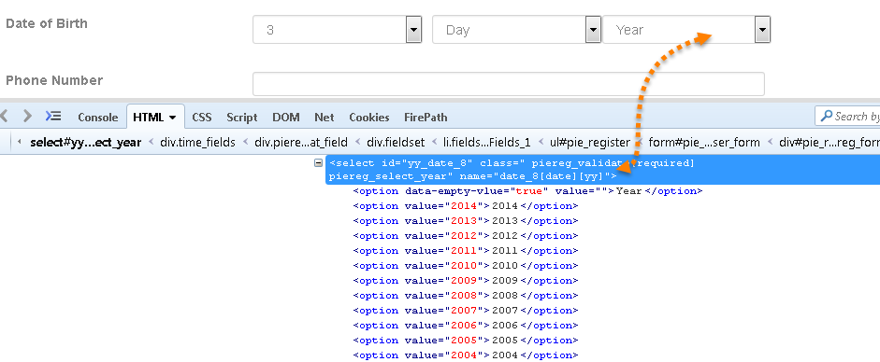
Drop Down with Select Class

Slide 91
DropDown & Multiple Select Operation
Dropdown are formed using select tag in html, if dropdown is not formed with select tag you cannot use this Select Class methods in selenium.
To Handle Drop Down And Multi Select List in Selenium we use the following types of Select Methods:
selectByVisibleText Method
selectByIndex Method
selectByValue Method
Note: to verify if drop down allows multiple selection use method isMultiple();

Slide 92
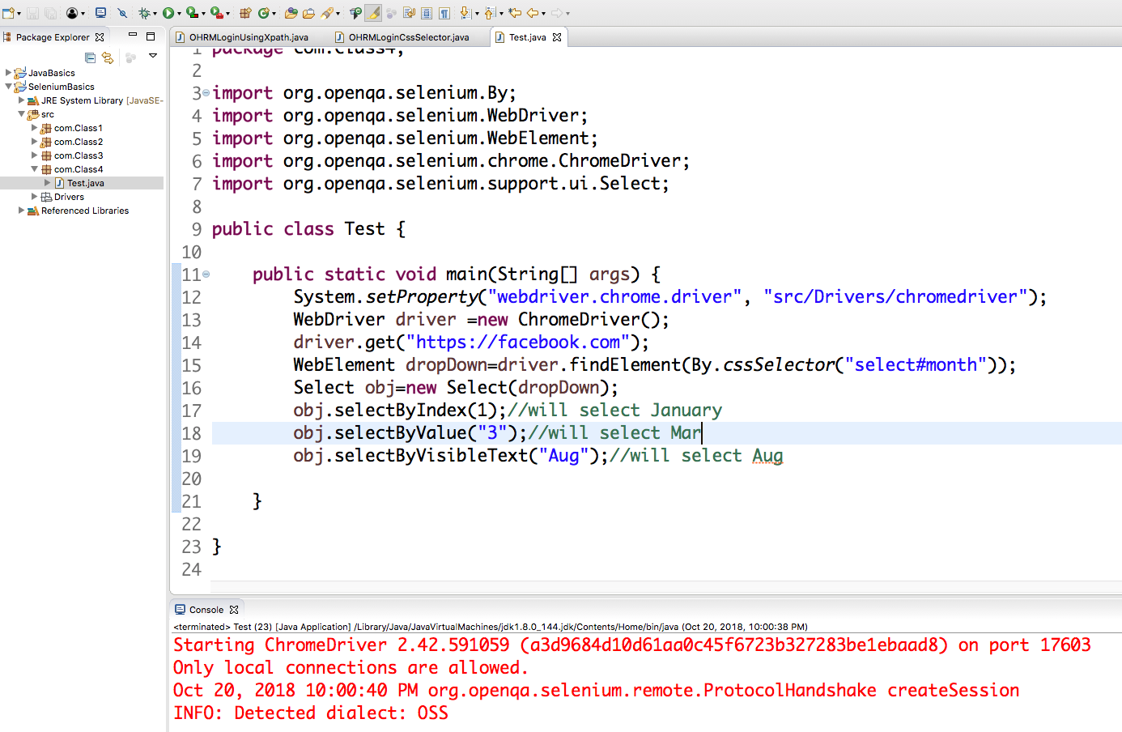
DropDown demo

Slide 93
DropDown & Multiple Select Operation
getOptions( ) : List<WebElement> –This gets the all options belonging to the Select tag. It takes no parameter and returns List<WebElements>.
Command - oSelect.getOptions();
Sometimes you may like to count the element in the dropdown and multiple select box, so that you can use the loop on Select element.

Slide 94
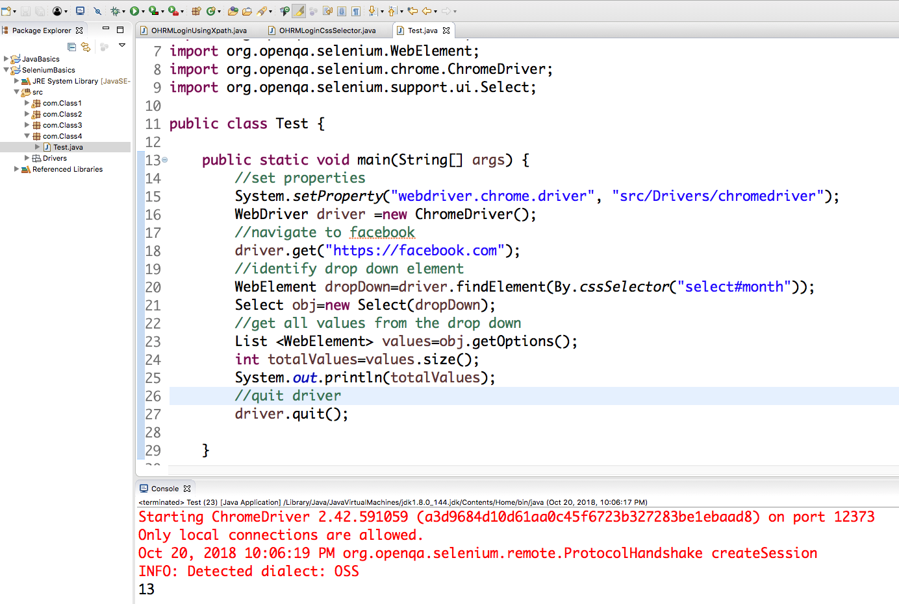
DropDown getOptions()

Slide 95
Test Case
TC 1: Facebook dropdown verification
Open chrome browser
Go to “https://www.facebook.com”
Verify:
month dd has 12 month options
day dd has 31 day options
year dd has 115 year options
Select your date of birth
Quit browser

Slide 96
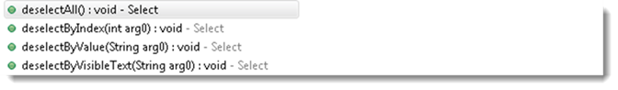
DeSelect Methods
The way we select different values of DropDown & Multi Select, the same way we can also deselect the values.
But the only challenge is these methods do not work for DropDown and only work for Multi Select elements.
In case you want to deselect any pre-selected option, that can be done with either deselectAll(), deselectByIndex, deselectByValue and deselectByVisibletext.

Slide 97
1. deselectAll( ) : void – Clear all selected entries. Valid when the SELECT supports multiple selections.
Command - oSelect.deselectAll;
2. deselectByIndex(int arg0) : void –Deselect the option at the given index.
Command - oSelect.deselectByIndex;
3. deselectByValue(String arg0) : void –Deselect all options that have a value matching the argument.
Command - oSelect.deselectByValue;
4. deselectByVisibleText(String arg0) : void – Deselect all options that display text matching the argument.
Command - oSelect.deselectByVisibleText
5. isMultiple( ) : boolean – Tells whether the SELECT element support multiple selecting options at the same time or not. It accepts nothing by returns boolean value(true/false).
Command - oSelect.isMultiple();
This is done by checking the value of the “multiple” attribute.

Slide 98
HomeWork
TC 1: Amazon Department List Verification
Open chrome browser
Go to “http://amazon.com/”
Verify how many department options available.
Print each department
Select Computers
Quit browser
TC 2: Select and Deselect values
Open chrome browser
Go to “http://jiravm.centralus.cloudapp.azure.com:8081/index.html”
Click on “Input Forms” links
Click on “Select Dropdown List” links
Select value from “Select List Demo” section
Verify value has been selected
Select 4 options from “Multi Select List Demo”
Deselect 1 of the option from the dd
Quit browser

Slide 99
Selenium
Class 6

Slide 100
Agenda
Switch To Commands:
Handle Alerts
Handle Frames

Slide 101
Alerts/PopUps
Alerts are basically popup boxes that away focus from the current browser and forces to read the alert message.
We need to do some action such as accept or dismiss the alert box to resume our task on the browser.
Alert prevents the user from accessing other parts of the web page until the box is closed.
Alerts will not allow any action on the underlying webpage if they are present. So if an alert is present on the webpage and you try to access any of the element in the underlying page you will get following exception:
UnhandledAlertException: Modal dialog present

Slide 102
Alerts/PopUps
There are two types of alerts:
Windows Based Alerts
Web Based/Browser Based/JavaScript Alerts
To handle alert window in Selenium Webdriver we have predefined Interface Alert .
Since alert is separate window so before using methods from Alert Interface we have to switch to alert window using switchTo() method
Alert alert = driver.switchTo().alert();

Slide 103
Handle Alerts
Selenium provides us with an interface called Alert.
It is present in the org.openqa.selenium.Alert package.
Alert interface gives us following methods to deal with the alert:
accept() To accept the alert
dismiss() To dismiss the alert
getText() To get the text of the alert
sendKeys() To write some text to the alert

Slide 104
Simple Alert
Simple alerts just have a OK button on them. They are mainly used to display some information to the user.
Important point to note is that we need to switch from main window to an alert using the driver.switchTo().alert().
Alert simpleAlert = driver.switchTo().alert();
String alertText = simpleAlert.getText();
system.out.println("Alert text is " + alertText);
simpleAlert.accept();

Slide 105
Confirmation Alert
This alert comes with an option to accept or dismiss the alert.
To accept the alert you can use Alert.accept() and to dismiss you can use the Alert.dismiss(). Here is the code to dismiss a prompt alert.
Alert confirmationAlert = driver.switchTo().alert();
String alertText = confirmationAlert.getText();
system.out.println("Alert text is " + alertText);
confirmationAlert.dismiss();

Slide 106
Prompt Alert
In prompt alerts you get an option to add text to the alert box.
This is specifically used when some input is required from the user.
We will use the sendKeys() method to type something in the Prompt alert box.
Alert promptAlert = driver.switchTo().alert();
String alertText = promptAlert .getText();
system.out.println("Alert text is " + alertText);
//Send some text to the alert
promptAlert .sendKeys("Accepting the alert");
promptAlert .accept();

Slide 107
Test Case
TC 1: JavaScript alert text verification
Open chrome browser
Go to “http://jiravm.centralus.cloudapp.azure.com:8081/index.html”
Click on “Alerts & Modals” links
Click on “Javascript Alerts” links
Click on button in “Java Script Alert Box” section
Verify alert box with text “I am an alert box!” is present
Click on button in “Java Script Confirm Box” section
Verify alert box with text “Press a button!” is present
Click on button in “Java Script Alert Box” section
Enter text in the alert box
Quit browser

Slide 108
Handle IFrames / Frames
In some application for better visibility developer use frame concept in web pages.
What is iFrame? An iFrame (Inline Frame) is an HTML document embedded inside the current HTML document on a website.
iFrame HTML element is used to insert content from another source, such as an advertisement, into a Web page.
A Web designer can change an iFrame's content without making them reload the complete website.
A website can have multiple frames on a single page. And a frame can also have inner frames (Frame in side a Frame)
We can handle frames/iframes present in the webpage using driver.switchTo() command in selenium webdriver.
Frame/iFrame is nothing but another webelement in html page, which displays another part of webpage.

Slide 109
How to Identify Frame ?
There are many ways to identify the Frame. We will see the easiest way to identify the frame. Let's see the step by step procedure-
Right click on the element. Check if “This Frame” option is available. If This frame option is available, it means that the element is inside a frame.
View page source of the web page and check if any tag is available for ‘iframe’.
It will show the iFrame tag for the frame inside which the webelement is present.
To work with the frames you need to switch to frame first.
In Selenium to work with Frames, we have different ways to handle frame depending on the need.

Slide 110
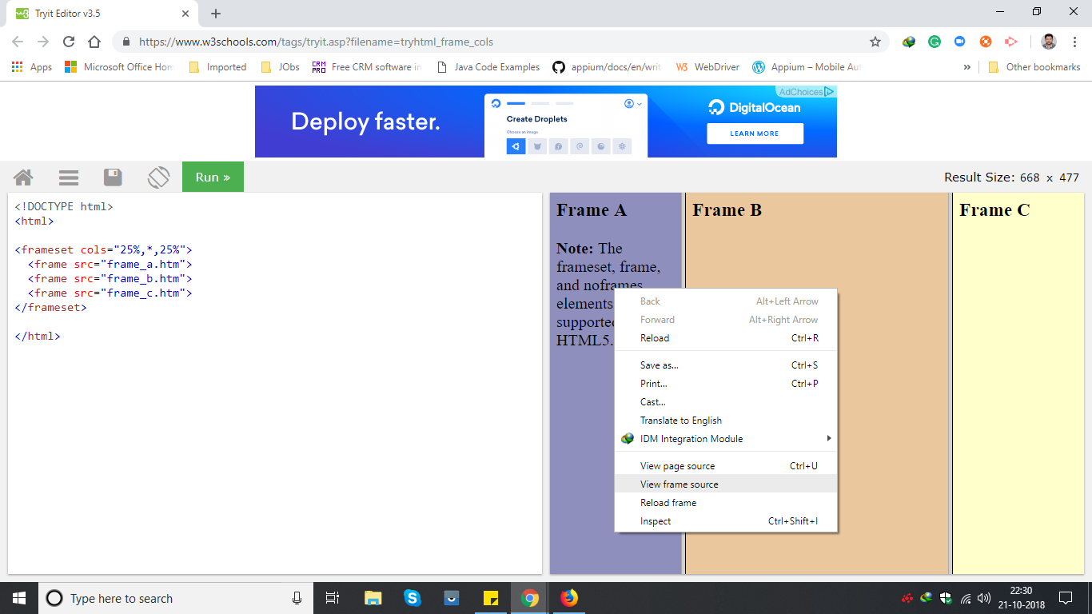
On Chrome : View frame source option get enable when you mouse hover on element

Slide 111
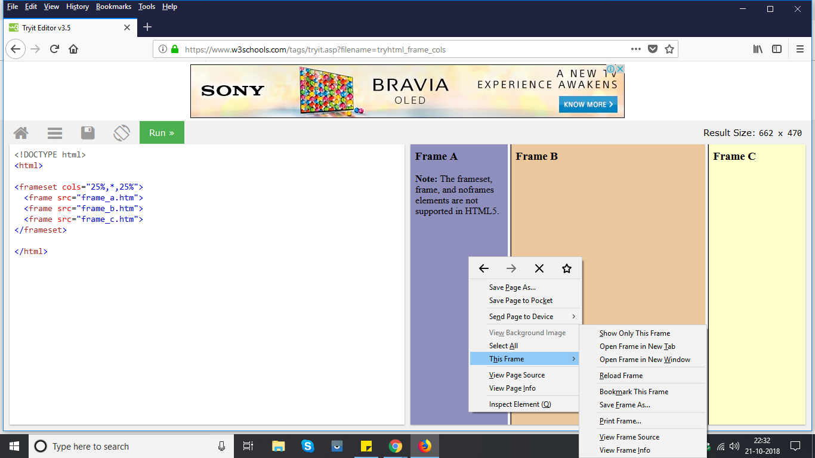
On Firefox : This frame option get enable

Slide 112
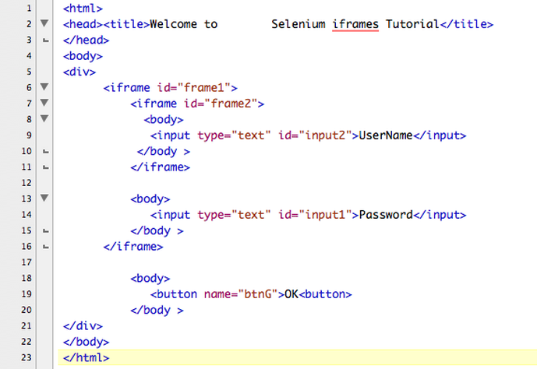

Slide 113
Switch to Frames by Name or ID
Select a frame by its name or ID. Frames located by matching name attributes are always given precedence over those matched by ID.
Syntax - driver.switchTo().frame(String name/id);
driver.switchTo().frame("iframe1");
driver.quit();
Throws: NoSuchFrameException - If the frame is not found

Slide 114
Switch to Frame by WebElement
we can switch to an iFrame by simply passing the iFrame WebElement to the driver.switchTo().frame() command.
First find the iFrame element using any of the locator strategies and then passing it to switchTo command.
WebElement iframeElement = driver.findElement(By.id("IF1"));
//now use the switch command
driver.switchTo().frame(iframeElement);
driver.quit();
Throws: NoSuchFrameException - If the given element is neither an iframe nor a frame element.

Slide 115
Switch to Frames by Index
Index of an iFrame is the position at which it occurs in the HTML page.
Select a frame by its (zero-based) index. That is, if a page has multiple frames (more than 1), the first frame would be at index "0", the second at index "1" and so on.
Once the frame is selected or navigated , all subsequent calls on the WebDriver interface are made to that frame. i.e the driver focus will be now on the frame.
What ever operations we try to perform on pages will not work and throws element not found as we navigated / switched to Frame.
Syntax - driver.switchTo().frame(int arg0);
driver.switchTo().frame(0);
driver.quit();
Throws: NoSuchFrameException - If the frame is not found.

Slide 116
Switch to Frames by Index
Sometimes when there are multiple Frames (Frame in side a frame), we need to first switch to the parent frame and then we need to switch to the child frame.
In the below HTML, you can see we have frame2 inside frame1 and web elements inside the frame2.
//Switch to child frame
driver.switchTo().frame("frame1").switchTo().frame("frame2");
driver.findElement(By.id("input2")).sendKeys("Username");
driver.findElement(By.id("input1")).sendKeys("Password");
driver.findElement(By.cssSelector("button[name='btnG']")).click();
//switch to parent frame
driver.switchTo().frame("frame1");

Slide 117
Switching back to Main page from Frame
After working with the frames, main important is to come back to the web page.
if we don't switch back to the default page, driver will throw an exception.
Once you are done with all the task in a particular iFrame we need to switch back to the main page using the switchTo().defaultContent().
WebElement iframeElement = driver.findElement(By.id("IF1"));
//now use the switch command
driver.switchTo().frame(0);
//Do all the required tasks in the frame 0
//Switch back to the main window
driver.switchTo().defaultContent();
driver.quit();

Slide 118
Test Case
TC 1: Syntax Frame verification
Open chrome browser
Go to “http://jiravm.centralus.cloudapp.azure.com:8081/index.html”
Click on “Others” link
Click on “Iframe” link
Click on the “Home” link inside the one frame
Verify “Syntax logo” is displayed in another frame
Quit browser

Slide 119
Selenium
Class 7

Slide 120
Agenda
Handle Windows Synchronization & Waits in Selenium

Slide 121
Multiple Windows in Selenium Webdriver
There will be times when we will required to perform some testing, where the testing operations open a new browser/tab, test case may required you to perform some tasks on the newly opened browser window/tab and return back to original window to perform the remaining tasks.
Even if the window/tab is currently on focus but still it is not an active window, so to perform some tasks we need to switch to new browser window/tab in selenium webdriver.
Situations when we are likely to deal with multiple windows:
Filling forms may require selecting the date from a separately opened window
Clicking on some link/button can open another window
Handling Advertisement windows

Slide 122
Switch Window Commands
Selenium WebDriver assigns an alphanumeric id to each window as soon as the WebDriver object is instantiated.
This unique alphanumeric id is called window handle. Selenium uses this unique id to switch control among several windows.
In simple terms, each unique window has a unique ID, so that Selenium can differentiate when it is switching controls from one window to the other.
GetWindowHandle Command
Purpose: To get the window handle of the current window.
//Return a string of alphanumeric window handle
String handle= driver.getWindowHandle();

Slide 123
Switch Window Commands
GetWindowHandles Command
Purpose: To get the window handle of all the current windows.
//Return a set of window handle
Set<String> handle= driver.getWindowHandles();
SwitchTo Window Command
Purpose: WebDriver supports moving between named windows using the “switchTo” method.
driver.switchTo().window("windowName");

Slide 124
Test Case
TC 1: Windows Handling
Open chrome browser
Go to “http://jiravm.centralus.cloudapp.azure.com:8081/index.html”
Click on “Javascript Alerts” link
Click on “Window Popup Modal” link
Click on the “ Follow On Instagram” button
Verify title of the page is “Syntax Technologies (@syntaxtechs) • Instagram photos and videos”
Click on the “Like us On Facebook ” button
Verify title of the page is “Go to Facebook Home”
Quit the browser
NOTE: Selenium execution could be too fast, please use Thread.sleep

Slide 125
Test Case
TC 1: Form Submission
Open chrome browser
Go to “http://166.62.36.207/syntaxpractice/”
Click on “Input Forms” link
Click on “Input Form Submit” link
Using different locator submit the form and click on “Send” button
Quit the browser

Slide 126
Synchronization Waits in Selenium
What is wait ? Why we need it ?
It is the process of matching the speed of action and reaction, selenium does the action and web application shows the reaction.
Example: Click Login button gmail login (selenium does this action) web application navigates to the inbox(reaction).
Selenium Wait commands play an important role while executing Selenium tests. When a page is loaded to browser, the elements within that page may load at different time intervals.
This makes locating elements difficult, if the element is not present in the DOM, it will raise ElementNotVisibleExceptionexception.
Waits help the user to troubleshoot issues while redirecting to different web pages by refreshing the entire web page and reloading the new web elements.

Slide 127
Synchronization Waits in Selenium
In most of the cases the selenium does the action in micro or milliseconds but the application takes time in seconds.
At the same time selenium will not wait till it loads or becomes visible at the time selenium will not able to find the element within the java processing time so selenium throws “NoSuchElementException᾿.
We cannot alter the speed of the application, so we must slow down selenium.

Slide 128
Synchronization Waits in Selenium
There are several ways to synchronize the selenium with application
pageLoadTimeout
ImplicitWait
ExplicitWait or WebdriverWait
FluentWait

Slide 129
Page Load Timeout in Selenium Webdriver
Page load timeout in selenium requests/set the time limit for a page to load, if the page is not loaded within the given time frame selenium throws TimeOutException exception.
Page Load timeout is applicable only to driver.get() and driver.navigate().to() methods in selenium webdriver.
Page load timeout is not applicable when user clicks a link to open a page.
driver.manage().timeouts().pageLoadTimeout(30, TimeUnit.SECONDS);

Slide 130
Waits in Selenium Webdriver
Selenium Webdriver provides two types of waits:
ImplicitWait
ExplicitWait: WebDriver Wait
Fluent Wait

Slide 131
Implicit wait
An implicit wait is to tell WebDriver to poll the HTML DOM for a certain amount of time when trying to find an element or elements if they are not immediately available.
The default setting is 0. Once when we define the implicit wait, it will set for the life of the WebDriver object instance.
It is a mechanism which will be written once and applied for entire session automatically. It should be applied immediately once we initiate the Webdriver.

Slide 132
Implicit wait
Implicit wait will not work for all the commands/statements in the application.
It will work only for "FindElement" and "FindElements" statements.
If we set implicit wait, find element will not throw an exception if the element is not found in first instance, instead it will poll for the element until the timeout and then proceeds further.
We should always remember to add the below syntax immediately below the Webdriver statement.
driver.manage().timeouts().implicitlyWait(20, TimeUnit.SECONDS);

Slide 133
Implicit wait
import java.util.concurrent.TimeUnit – To be able to access and apply implicit wait in our test scripts, we are bound to import this package into our test script
In implicit wait, if webdriver cannot find webelement in starting, it will wait for specified time duration and only then throw NoSuchElementException
Webdriver will not search during this wait interval. Once specified time is over, it will try to search again for last time before throwing any exception.
If element will be found before the specified time, it will return that element and the the rest of the time will be ignored
In Fluent wait and explicit wait, if wait time is 30 seconds, webdriver tries to search for element after some specified time say 500 milliseconds.

Slide 134
Explicit wait
Types of Explicit Waits:
WebDriverWait
FluentWait
We need to define a wait statement for certain condition to be satisfied until the specified timeout period.
If the Webdriver finds the element within the timeout period the code will get executed.
Explicit wait is mostly used when we need to Wait for a specific content/attribute change after performing any action, like when application gives AJAX call to system and get dynamic data and render on UI.
Example: Like there are drop-downs Country and State, based on the country value selected, the values in the state drop-down will change, which will take few seconds of time to get the data based on user selection.
WebDriverWait wait = new WebDriverWait(driver, 10);
wait.until(ExpectedConditions.visibilityOfElementLocated
(By.id("statedropdown")));

Slide 135
Types of
ExpectedCondition
in Explicit wait
We can use WebDriverWait class in many different cases. When ever we need to perform any operation on element, we can use webdriver wait to check if the element is present or visible or enabled or disabled or clickable etc.
ExpectedConditions class provides a great help to deal with scenarios where we have to ascertain for a condition to occur before executing the actual test step.
ExpectedConditions class comes with a wide range of expected conditions that can be accessed with the help of the WebDriverWait reference variable and until() method.

Slide 136
Types of
ExpectedCondition
in Explicit wait
elementToBeClickable()
Selenium waits for an element to become clickable like disabled state to normal state, selenium moves to next line of code if the element becomes clickable before the timeout otherwise selenium throws 'TimeOutException'
visibilityOfElementLocated()
Selenium waits for visibility of element when we use 'visibilityOfElementLocated()', when element is visible, it moves to next line of code, in case if element is not visible before the specified time, then selenium Throws 'TimeOutException'
elementToBeSelected()
Selenium waits for an element to be selected when we use 'elementToBeSelected()', when selenium finds the element is selected it moves to next line of code, in case if element is not selected before the specified time, then selenium Throws 'TimeOutException'

Slide 137
Types of
ExpectedCondition
in Explicit wait
textToBePresentInElement()
Selenium waits for an element to have particular text when we use 'textToBePresentInElement()', when selenium finds the element have particular text it moves to next line of code, in case if element does not have text before the specified time, then selenium Throws 'TimeOutException'
alertIsPresent()
Selenium waits for an alert to be present when user writes 'alertIsPresent()', when selenium finds the alert it moves to next line of code, in case if alert is not present before the specified time, then selenium Throws 'TimeOutException'
Note- 95 % of our test can be handled via explicit wait

Slide 138
Test Case
In Class
TC 1: Verify element is present
Open chrome browser
Go to “https://the-internet.herokuapp.com/”
Click on “Click on the “Dynamic Loading” link
Click on “Example 1...” and click on “Start”
Verify element with text “Hello World!” is displayed
Close the browser
HomeWork
TC 2: Verify element is clickable
Open chrome browser
Go to “https://the-internet.herokuapp.com/”
Click on “Click on the “Dynamic Controls” link
Select checkbox and click Remove
Click on Add button and verify “It's back!” text is displayed
Close the browser
TC 3: Verify element is enabled
Open chrome browser
Go to “https://the-internet.herokuapp.com/”
Click on “Click on the “Dynamic Controls” link
Click on enable button
Enter “Hello” and verify text is entered successfully
Close the browser

Slide 139
Fluent Wait
FluentWait can define the maximum amount of time to wait for a specific condition and frequency with which to check the condition before throwing an “ElementNotVisibleException” exception.
We use FluentWait commands mainly when we have web elements which sometimes visible in few seconds and sometimes take more time than usual. Mainly in Ajax applications. We could set the default polling period based on our requirement. We could ignore any exception while polling an element.
FluentWait wait = new FluentWait(driver);
wait.withTimeout(Duration.ofSeconds(30));
wait.pollingEvery(Duration.ofSeconds(1));
wait.ignoring(NoSuchElementException.class);

Slide 140
HomeWork
TC 1: Add Employee
Open chrome browser
Go to “http://166.62.36.207/humanresources/symfony/web/index.php/auth”
Login into the application
Add Employee
Log out
Quit the browser

Slide 141
Selenium
Class 8

Slide 142
Agenda
How to handle Web Tables

Slide 143
What is Table?
Web tables are basically group of elements that are logically stored in a row and column format. It is used to organize similar information in a web page.
In HTML, table is created using <table> tag. Web table is a HTML structure for creating rows and columns on a Web page.
A web table can consists below parts:
Header(s): It is created using <th> tag.
Row(s):It is created using <tr> tag.
Columns(s):It is created using <td> tag.
There are two types of HTML tables:
Static tables: Data is static i.e. Number of rows and columns are fixed.
Dynamic tables: Data is dynamic i.e. Number of rows and columns are NOT fixed.
When the table is dynamic in nature, we cannot predict its number of rows and columns. Selenium Webdriver allows us to access dynamic web tables by their X-path

Slide 144
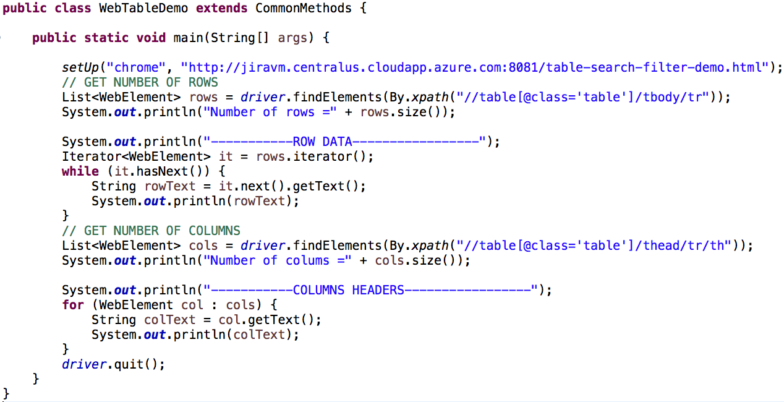
Fetch number of rows and columns from WebTable

Slide 145
Test Case
TC 1: Table headers and rows verification
Open chrome browser
Go to “http://166.62.36.207/syntaxpractice/”
Click on “Table” link
Click on “ITable Data Search” link
Verify second table consist of 5 rows and 4 columns
Print name of all column headers
Print data of all rows
Quit Browser

Slide 146
Fetch cell value of a particular row & column of Dynamic Table
List<WebElement> rows=driver.findElements(By.xpath("//table[@id='resultTable']/tbody/tr"));
List<WebElement> cols=driver.findElements(By.xpath("//table[@id='resultTable']/thead/tr/th"));
System.out.println("Number of rows is - " + rows.size() + " and columns is - " + cols.size());
for(int i=1; i<=rows.size(); i++) {
WebElement row=driver.findElement(By.xpath("//table[@id='resultTable']/tbody/tr["+i+"]"));
String rowData = row.getText();
System.out.println("Row "+i+" data is "+rowData);
if(rowData.contains("0003")) {
driver.findElement(By.xpath("//table[@id='resultTable']/tbody/tr["+i+"]/td/input")).click();
System.out.println("Clicked");
break;
}
}

Slide 147
Test Case
TC 1: Table headers and rows verification
Open chrome browser
Go to “http://secure.smartbearsoftware.com/samples/testcomplete11/WebOrders/login.aspx”
Login to the application
Verify customer “Susan McLaren” is present in the table
Click on customer details
Update customers last name and credit card info
Verify updated customers name and credit card number is displayed in table
Close browser

Slide 148
HomeWork
TC 1: Delete Employee
Open chrome browser
Go to “http://166.62.36.207/humanresources/symfony/web/index.php/auth”
Login into the application
Add Employee
Verify Employee has been added
Go to Employee List
Delete added Employee
Quit the browser

Slide 149
Selenium
Class 9

Slide 150
Agenda
How to handle Calendars

Slide 151
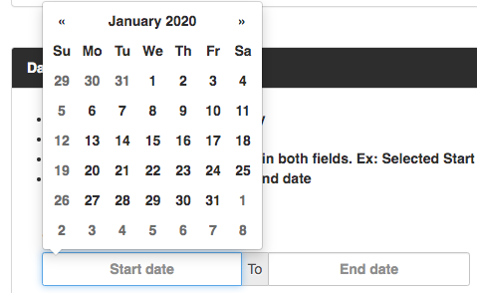
Select Date from DatePicker in Selenium [calendar]
When we need to automate an airway, hotel, or similar websites we need to deal with Date Pickers.
What Is A Date Time Picker Control?
A date-time picker (aka DTP) control provides a simple and user-friendly interface for exchanging date and time information with a user.
For example, you can use a DTP control for asking the user to input a date and then quickly fetch the selection. Most of the time, it appears as an input field in an HTML form.
When the user selects a date, the feedback gets shown as the input’s value.

Slide 152
Approach to handle calendar in Selenium Webdriver
Step 1- Click on calendar
Step 2- Get all td of table using findElements method
Step 3- using for loop get text of all td elements
Step 4- using if else condition we will check specific date
Step 5- If date is matched then click and break the loop.

Slide 153
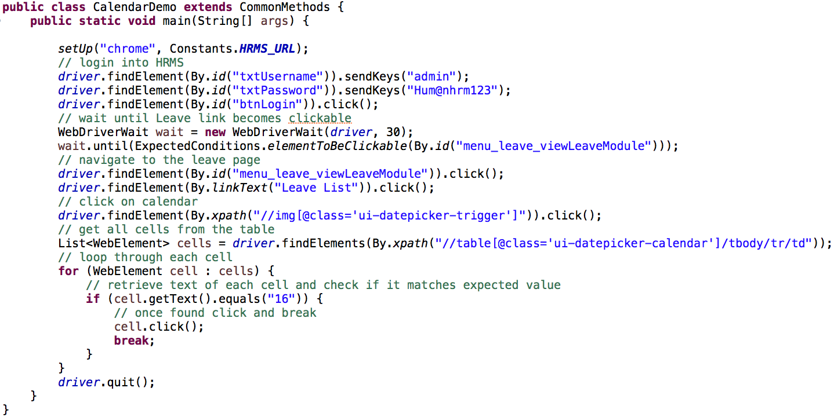
Select Date from Calendar

Slide 154
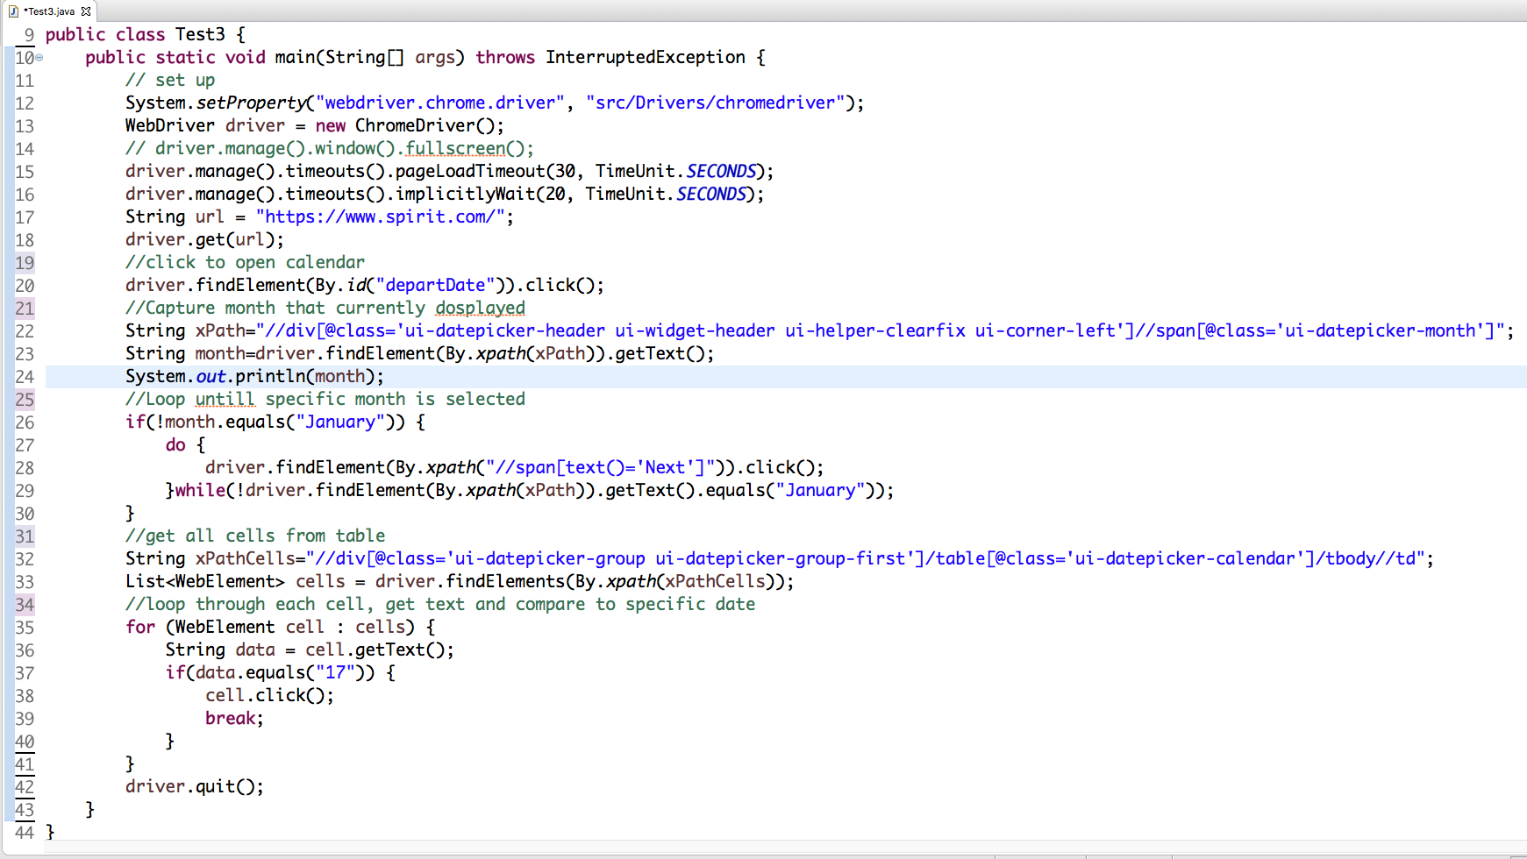

Slide 155
HomeWork
TC 1: Leave List Search Validation
Open chrome browser
Go to “http://166.62.36.207/humanresources/symfony/web/index.php/auth”
Login into the application
Select Leave List
Select from December 1, 2019 until January 31, 2020
Check only Pending approval
Click on Search
Validate “No Records Found” is displayed
Quit the browser

Slide 156
Test Case
TC 1: Table headers and rows verification
Open chrome browser
Go to “https://www.aa.com/homePage.do”
Enter From and To
Select departure as May 14 of 2020
Select arrival as November 8 of 2020
Click on search
Close browser

Slide 157
Selenium
Class 10

Slide 158
Agenda
Taking screenshots in Selenium
Advanced xPath
Javascript Executor
Action Class
File Upload.

Slide 159
HomeWork
TC 1: Table headers and rows verification
Open chrome browser
Go to “https://www.aa.com/homePage.do”
Enter From and To
Select departure as May 14 of 2020
Select arrival as November 8 of 2020
Verify “Choose flights” text is displayed
Close browser

Slide 160
Screenshot using Selenium
Screenshots are desirable for bug analysis. In automation, it is necessary to take the screenshot for verification so we can prove also that our test case has covered certain functionality or not.
Test cases may fail while executing the test cases. While we are executing the test cases manually we just take a screenshot and place in a result repository. The same can be done by using Selenium WebDriver.
It's very important to take screenshot when we execute a test script. When we execute huge number of test scripts, and if some test fails, we need to check why the test has failed.
It helps us to debug and identify the problem by seeing the screen shot.

Slide 161
Screenshot using Selenium
Failures may occur because of below reasons:
Actual and Expected values are not matching
When there is no element
When page takes more time to load
When an unexpected alert comes in to focus
When there is Assertion issues
There is an interface called TakesScreenshot which provides
getScreenshotAs method and which selenium uses to take
screenshot.

Slide 162
Screenshot using Selenium
Our browser classes (Like ChromeDriver, FirefoxDriver ...) extends
RemoteWebdriver and RemoteWedriver implements
TakesScreenshot Interface along with Webdriver Interface.
We can take screenshot of a webpage using getScreenshotAs method from the TakesScreenshot, but we cannot initialize TakesScreenshot as it is an interface.
So to take screenshot of the page we have to cast our driver object to TakesScreenshot interface type:
TakesScreenshot scrShot =(TakesScreenshot)webdriver;
Note: casting is a process of converting 1 dataType/objectType to another

Slide 163
Screenshot using Selenium
Convert webdriver object to TakesScreenshot
TakesScreenshot scrShot =(TakesScreenshot)webdriver;
Call getScreenshotAs method to create image file
File SrcFile=scrShot.getScreenshotAs(OutputType.FILE);
Copy file at destination
FileUtils.copyFile(SrcFile, new File(DestFilepath/name and extension));

Slide 164
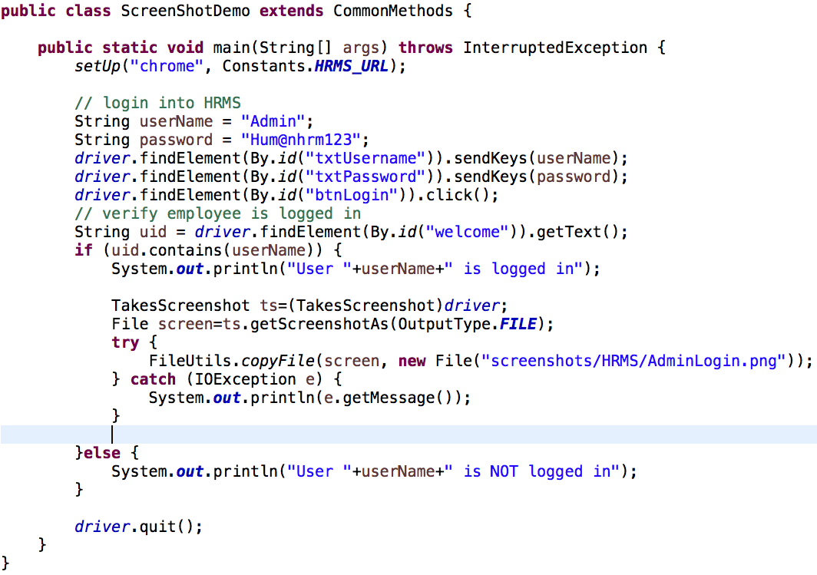

Slide 165
Advanced xPath
Sometimes multiple elements will have the same attribute values or no attributes defined in its html and in this case we need to work on creating unique xpath.
To find an element which is not having an identity, We find the related elements of that element
and access that element using a relation between identified element

Slide 166
Advanced xPath
If Parent is having unique identification
parentXpath/childTagName
If immediate child is having unique identification
childXpath/..
If the next element is having unique identification
nextElementXpath/preceding-sibling::tagName
If the previous element is having unique identification
previousElementXpath/following-sibling::tagName

Slide 167
Test Case
TC 1: HRMS Login
Navigate to “http://166.62.36.207/humanresources/symfony/web/index.php/auth”
Login to the application by writing xpath based on “parent and child relation”
TC 2: HRMS Login
Navigate to “http://166.62.36.207/humanresources/symfony/web/index.php/auth”
Login to the application by writing xpath based on “following and preceding siblings”

Slide 168
JavascriptExecutor
JavaScriptExecutor is something which present in every selenium tool and in all the languages we can execute it on the browser.
JavaScriptExecutor allows you to run pure Javascript code irrespective of the Selenium language binding(Java, C#, Python etc.) you are using.
JavaScriptExecutor is an interface which provides the mechanism to execute Javascript through selenium driver.
We should go for JavaScriptExecutor only when we are not able to perform a particular task with our selenium like sometimes we may not be able click a element

Slide 169
JavascriptExecutor
Using JavaScriptExecutor we can perform:
Click on some elements
Scroll page
Refresh page
Highlight an element
JavaScriptExecutor provides “execute script” & "executeAsyncScript" methods, to run JavaScript in the context of the currently selected frame or window.

Slide 170
What is Javascript?
A Javascript is a small chunks of program that makes a website interactive. For example, a javascript could create a pop-up alert box , or provide a dynamic drop down menu.
JavaScript code can listen to event on the web page like reacting to a click on a button, reacting to when check a checkbox, or when we enter any value in to the text bar.
Javascript can change the content of the html page dynamically, it can also change the attributes of a web element like change the a button from disabled state to enabled state.

Slide 171
How to use JavascriptExecutor
We have to cast driver object into JavascriptExecutor type to use the methods present in the JavascriptExecutor interface.
cast the driver object to JavascriptExecutor
JavascriptExecutor js = (JavascriptExecutor) driver;
access the methods:
js.executeScript("javascript command");
Note: casting is a process of converting 1 dataType/objectType to another

Slide 172
Methods present in JavascriptExecutor
Perform Scroll on application using Selenium JavascriptExecutor js = (JavascriptExecutor)driver; js.executeScript("window.scrollBy(0,150)"); //Vertical scroll - down by 150 pixels
To scroll an app to specified elements JavascriptExecutor je = (JavascriptExecutor) driver; je.executeScript("arguments[0].scrollIntoView(true);", element);
Click Button using JavaScriptExecutor JavascriptExecutor js = (JavascriptExecutor)driver; js.executeScript("arguments[0].click();", element);
Highlight Element using JavaScriptExecutor JavascriptExecutor js = (JavascriptExecutor)driver; js.executeScript("arguments[0].style.backgroundColor='AnyColor'", element);

Slide 173
Handling Keyboard & Mouse Events
Sometimes in our test automation we will have to work with submenu and submenu items render in DOM only when we mouse hover on main menu.
In that case, we face difficulty to click on sub menu item. In order to perform mouse hover actions, we need to chain all of the actions that we want to achieve in one go.
To do this we need to make the driver move to the parent element that has child elements and click on the child element.
To achieve this we use Actions class in Selenium WebDriver.

Slide 174
Actions class
The Actions class allows us to build a chain of actions that we would like to perform.
Operations Supported by Actions Class:
Mouse Actions: helps user to perform all the operations related with mouse operations like : clicking, dragging, moving, clicking and dragging, hovering, double clicking, right clicking.
KeyBoard Actions: helps user to emulate keyboard operations on keys CTRL, ALT, Shift with KeyUp, KeyDown methods

Slide 175
Actions class
To create an object ‘action‘ of Selenium Actions class
Actions action=new Actions(driver);
To focus on element using WebDriver
action.moveToElement(element).perform();
To click on the element:
action.moveToElement(element).click().perform();
Mouse Over the element:
WebElement element = driver.findElement(By.xpath("xpath"));
//Create object 'action' of an Actions class
Actions action = new Actions(driver);
//Mouseover on an element
action.moveToElement(element).perform();

Slide 176
Available Methods in Selenium Actions Class
List of most commonly used keyboard and mouse events provided by the Selenium Actions class.
Method | Description
moveToElement(toElement) | It shifts the mouse to the center of the element.
contextClick() | Makes a context/right click at the existing mouse location.
doubleClick() | It performs a double-click at the existing mouse location.
dragAndDrop(source, target) | Invokes click-and-hold at the source location and moves to the location of the target element before releasing the mouse. Parameters: source – element to grab. target – element to release.

Slide 177
Right Click
We can right click an element or a webpage using Actions class in selenium and contextClick method.
WebElement element = driver.findElement(By.id("Selenium"));
// Create object for Actions class
Actions act = new Actions(driver);
// Perform Right click operation using action (object) on element.
act.contextClick(element).perform();

Slide 178
Double Click
Double click involves clicking on your mouse button twice to make a double click, and not just two clicks, in a short time the mouse button should be pressed twice, usually around half a second.
Used to do double-clicking to do different things, such as opening a program, opening a folder or choosing a word of text.
It double click on the current mouse position.
// Create object of Action class
Actions action = new Actions(driver);
// Find element using locator and store into WebElement
WebElement element = driver.findElement(By.id("elementId"));
// Perform Double click operation using action (object) on element.
action.doubleClick(element).perform();

Slide 179
Drag and Drop
We can drag and drop an element or a webpage using Actions class in selenium and dragAndDrop method.
public class DragAndDrop {
public static void main(String[] args) {
System.setProperty("webdriver.gecko.driver", "D:\\geckodriver.exe");
WebDriver driver = new FirefoxDriver();
driver.get(URL);
Actions act = new Actions(driver); // Create object of actions class
// Store Drag and Drop location into WebElement
WebElement drag = driver.findElement(By.xpath("put x path"));
WebElement drop = driver.findElement(By.xpath("put x path"));
// Drag element to destination
act.dragAndDrop(drag, drop).perform();
}
}

Slide 180
Drag and Drop
public class DragAndDrop {
public static void main(String[] args) {
System.setProperty("webdriver.gecko.driver", "D:\\geckodriver.exe");
WebDriver driver = new FirefoxDriver();
driver.get(URL);
Actions act = new Actions(driver); // Create object of actions class
// Store Drag and Drop location into WebElement
WebElement drag = driver.findElement(By.xpath("put x path"));
WebElement drop = driver.findElement(By.xpath("put x path"));
act.dragAndDrop(drag, drop).perform(); // Drag element to destination
}
}

Slide 181
HomeWork
TC 1: Drag and Drop verification
Open chrome browser
Go to “https://jqueryui.com/”
Click on “Droppable” link
Using mouse drag “Drag me to my target” to the “Drop Here”
Close the browser

Slide 182
Upload File using Selenium Webdriver
There are different ways to handle file uploads with Selenium Webdriver.
The first and the Easy way is simple case of just finding the element and typing the absolute path of the document into it.
WebElement element= driver.findElement(By.name("datafile"));
element.sendKeys("C:\Users\Sandesh\Desktop\testfile.txt");

Slide 183
Test Case
TC 1: Upload file and Take Screenshot
Navigate to “http://samples.gwtproject.org/samples/Showcase/Showcase.html#!CwFileUpload”
Upload file
Verify file got successfully uploaded and take screenshot

Slide 184
Selenium
Class 11

Slide 185
Agenda
Selenium Components
Page Object Model

Slide 186
Selenium
Selenium has 4 components:
Selenium Integrated Development Environment (IDE) [outdated]
Selenium Remote Control (RC) [outdated]
Selenium WebDriver
Selenium Grid

Slide 187
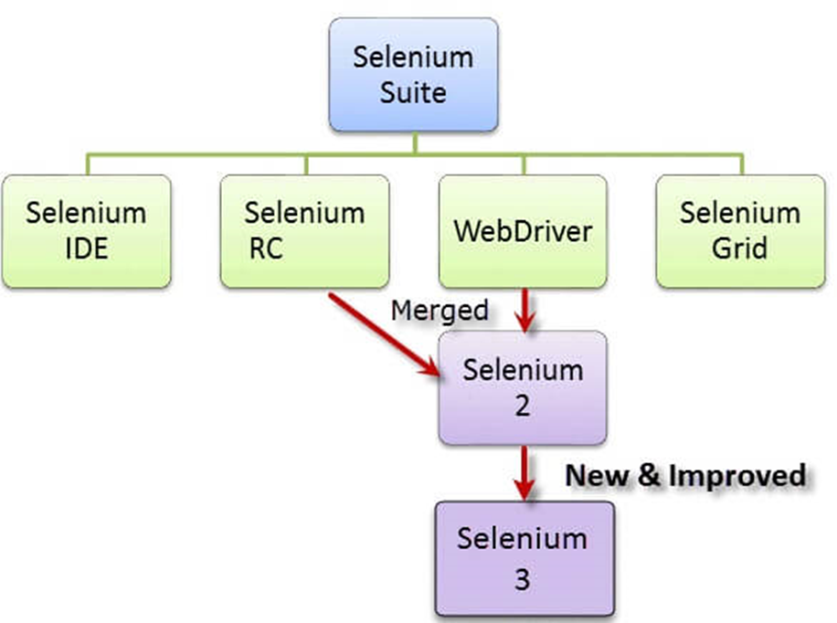
Selenium Component upto selenium 3.X
3.14

Slide 188
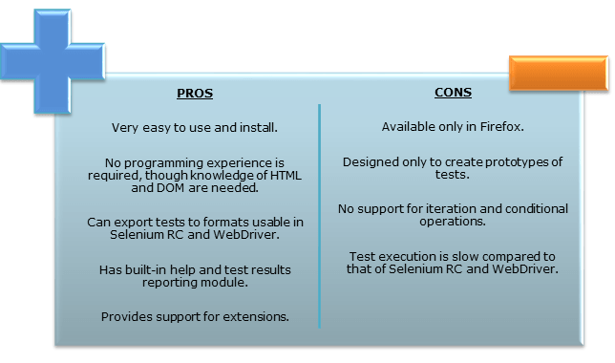
Selenium Integrated Development Environment (IDE) is the simplest tool in the Selenium suite and is the easiest to learn.
It is a Firefox plugin that you can install as easily as you can with other plugins. However, because of its simplicity, Selenium IDE should only be used as a prototyping tool.
If we want to create more advanced test cases, you will need to use Selenium WebDriver.
Selenium IDE

Slide 189
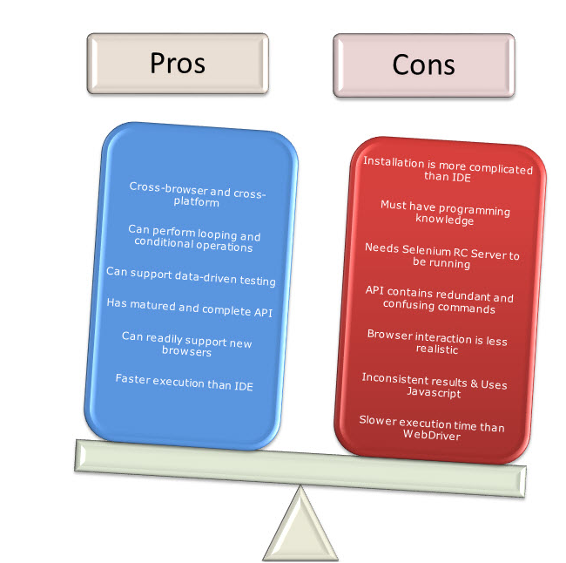
Selenium RC is the first automated web testing tool that allowed users to use a programming language they prefer.
As of version 2.25.0, RC can support the following programming languages:
Java
C#
PHP
Python
Perl
Ruby
Selenium RC

Slide 190
Selenium Grid
Selenium Grid is a tool used together with Selenium RC to run parallel tests across different machines and different browsers all at the same time. Parallel execution means running multiple tests at once.
Features:
Enables simultaneous running of tests in multiple browsers and environments.
Saves time enormously.
Utilizes the hub-and-nodes concept. The hub acts as a central source of Selenium commands to each node connected to it.
Selenium Grid

Slide 191
Selenium WebDriver proves itself to be better than both Selenium IDE and Selenium RC in many aspects.
It implements a more modern and stable approach in automating the browser's actions. WebDriver, unlike Selenium RC, does not rely on JavaScript for Automation.
It controls the browser by directly communicating with it. The supported languages are the same as those in Selenium RC.
Selenium WebDriver

Slide 192
What is POM?
Page Object model is a design pattern for enhancing test maintenance and reducing code duplication.
Page Object model is an object design pattern in Selenium, where web pages are represented as classes, and the various elements on the page are defined as variables on the class. All possible user interactions can then be implemented as methods on the class.
Page Object Model is a design pattern to create Object Repository for web UI elements. For each web page in the application there should be corresponding page class. This Page class will find the WebElements of that web page and also contains Page methods which perform operations on those WebElements.

Slide 193
Advantages of Page Object Model
Code reusability – We could achieve code reusability by writing the code once and use it in different tests.
Code maintainability – There is a clean separation between test code and page specific code such as locators and layout which becomes very easy to maintain code. Code changes only on Page Object Classes when a UI change occurs. It enhances test maintenance and reduces code duplication.
Object Repository – Each page will be defined as a java class. All the fields in the page will be defined in an interface as members. The class will then implement the interface.
Readability – Improves readability due to clean separation between test code and page specific code

Slide 194
Design and Implementation of POM using Selenium
How to Design:
For each Page in the application we will be creating a separate Java Class.
Each class is referred to as a PageObjects and returns other PageObjects to facilitate the flow between pages.
Page Object class is responsible to find the WebElements of that page and also hold methods which perform operations on those WebElements.
We will divide our Framework structure into 4 parts.
Test Base classes, Page classes, Test classes and Utility classes.
How to implement :
Page Object model without PageFactory
Page Object Model with PageFactory

Slide 195
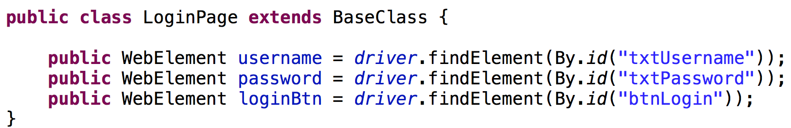
POM without PageFactory
In LoginPage class, we declared the Locators for the WebElement Username, Password, Login button and Logo and also we can define the actions that we can perform on these elements like input text and click the button.

Slide 196
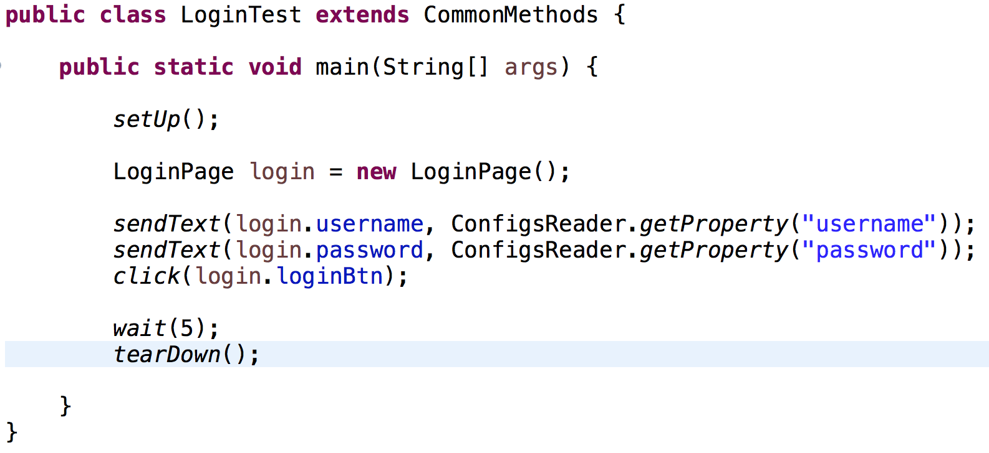
POM without PageFactory
The second thing we do is create the Separate Test Class for each page class or each functionality.
In our example, we are creating the LoginPageTest Class
In this Test Class, we create the Test scripts.
In our example, we are creating the Login test. We created the object of LoginPage class and called elements of LoginPage class in our Test Class to create the test script.

Slide 197
Test Case
TC 1: HRMS Logo Validation
Navigate to “http://166.62.36.207/humanresources/symfony/web/index”
Verify Syntax logo is displayed
Close the browser

Slide 198
Page Factory in Selenium POM Framework
Page Factory is an inbuilt page object model concept for Selenium WebDriver but it is very optimized.
Here as well we follow the concept of separation of Page Object repository and Test methods. Additionally with the help of PageFactory class we use annotations @FindBy to find WebElement.
We use initElements method to initialize web elements.
The PageFactory Class is an extension of the Page Object design pattern. It is used to initialize the elements of the Page Object or instantiate the Page Objects itself.
PageFactory is used to initialize elements of a Page class without having to use ‘FindElement’ or ‘FindElements’.
Annotations can be used to supply descriptive names of target objects to improve code readability.

Slide 199
@FindBy
In PageFactory, we use the @FindBy annotations to store the WebElements.
The @FindBy annotation supports all the other locators strategies that we use:
id, name, className, css, xpath, tagName, linkText and partialLinkText
@FindBy(name="txtUsername")
private WebElement user_name;

Slide 200
PageFactory.initElements
We should initialize page objects using initElements() method from PageFactory Class as below, Once we call initElements() method, all elements will get initialized.
PageFactory.initElements() static method takes the driver instance of the given class and the class type, and returns a Page Object with its fields fully initialized
PageFactory.initElements(driver, this);
or
PageFactory.InitElements(WebDriver, PageObject);

Slide 201
InitElements
This Instantiate an Instance /Elements of the given class.
This method will attempt to instantiate the class given to it, preferably using a constructor which takes a WebDriver instance as its only argument or falling back on a no-arg constructor.
An exception will be thrown if the class cannot be instantiated.
WebDriver – The driver that will be used to look up the elements
PageObjects – A class which will be initialised
Returns: An instantiated instance of the class with WebElement and List<WebElement> fields

Slide 202
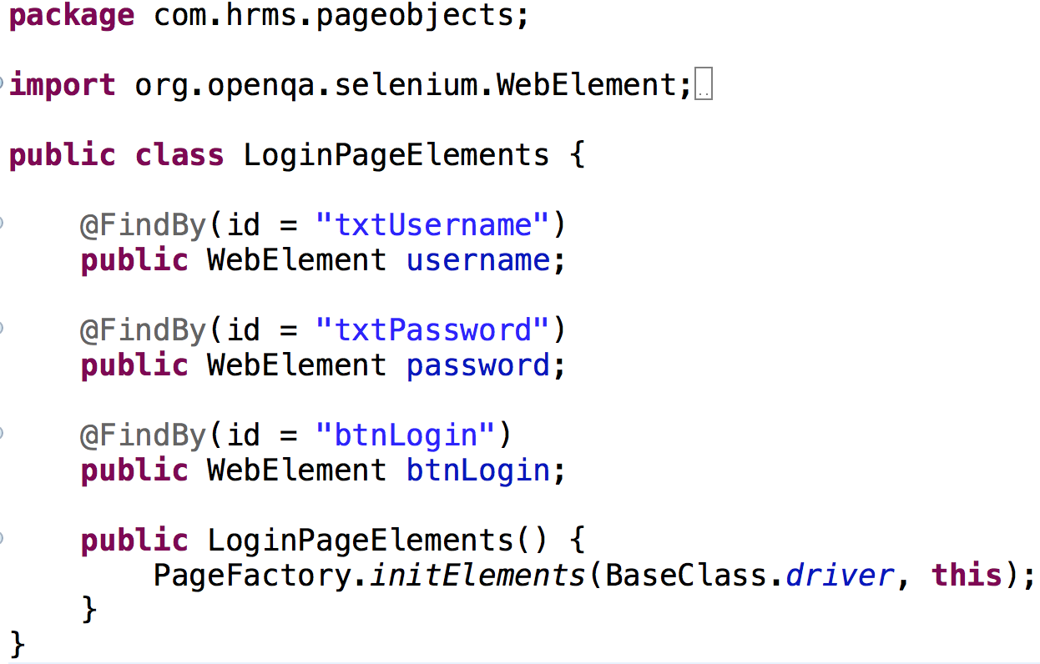
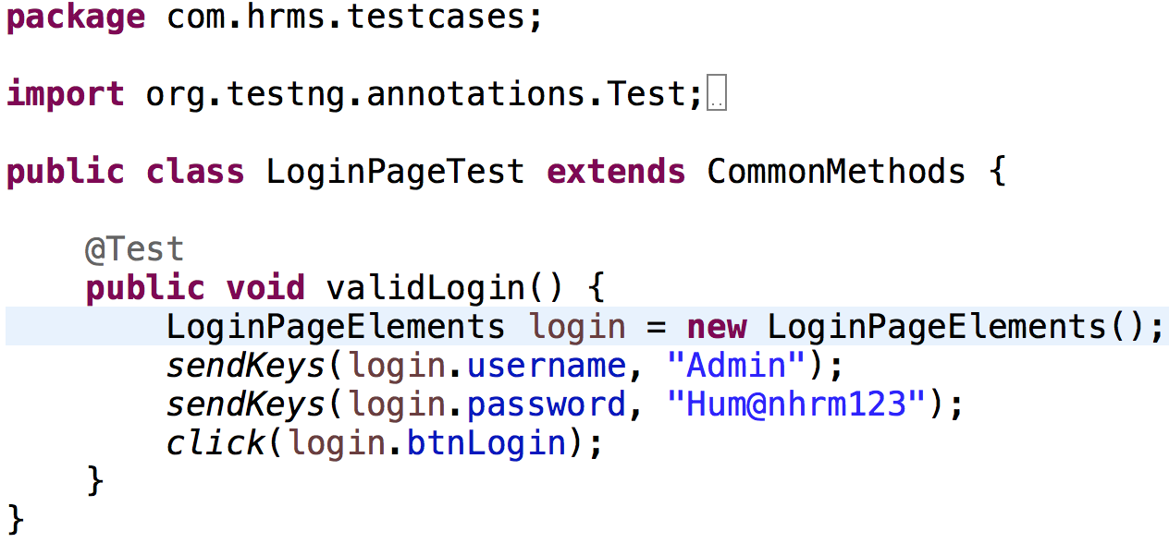
Page Factory in Selenium POM Framework

Slide 203
Test Case
TC 1: HRMS blank password validation
Navigate to “http://166.62.36.207/humanresources/symfony/web/index”
Enter valid username and leave password field empty
Click on login button
Verify error message with text “Password cannot be empty” is displayed
TC 2: HRMS blank username and password validation
Navigate to “http://166.62.36.207/humanresources/symfony/web/index”
Leave username and password field empty
Click on login button
Verify error message with text “Username cannot be empty” is displayed
TC 2: HRMS blank username and password validation
Navigate to “http://166.62.36.207/humanresources/symfony/web/index”
Enter valid username and wrong password
Click on login button
Verify error message with text “Invalid credentials” is displayed

